Slide 1
Faculty Learning, Teaching and Assessment (LTA) Update Autumn 2019
Phil Denton
p.denton@ljmu.ac.uk
Associate Dean, Education (ADE)
Faculty of Science
Presented: PBS 17/9/19

Slide 2
Ongoing Activities
LTA website: www.tinyurl.com/SCSLTA
Lab coat name printing with the handheld printer
LJMU LTA Awards: Nomination procedure unchanged
Academic diaries for all new Level 3 and 4 students
Walkabout Weeks: Casual observation of teaching observation via invitation in Weeks 6 and 23
LJMU LTA Conference registration social event
I can provide PowerPoint controllers and USB microphones (for Panopto) on request

Slide 3
New activities
Ten more tablets for in-class survey completion, 30 now available via nexustablet@ljmu.ac.uk and BS/321A
Foundation for citizenship profile raising: https://tinyurl.com/FFCVIDEO19
CareerSmart: resources enhanced by Careers Team

Slide 4
LJMU Teaching Quality Framework (new for 2019)
Faculty teaching observation becomes Peer Review:
Staff pairs for mutual peer review notified in October.
Various activities possible: intended to be supportive and non-judgmental with a reflection & enhancement focus.
Reviewee completes simple online declaration.
Alongside, the University will be introducing/overseeing:
Triennial teaching observation by a trained observer to provide feedback to inform development, discuss at PDPR, and evidence excellence.
Student evaluation of individual teaching via module evaluation.

Slide 5
Equality, Diversity and Inclusion (EDI)
School EDI reps: Shaqil Chaudary (PBS), Jon Bielby/Nicola Koyama (BES), Tori Sprung (SPS). Faculty rep: Phil Denton
Increased focus on equality, diversity and inclusion: LJMU analyses have underlined the differential experiences of black and minority ethnic (BAME) and Northern Irish students, and those from socially-deprived backgrounds
Three projects overseen by the Teaching and Learning Academy will take place in 2019/20 to address themes relating to achievement and completion:
• Whiteness and the Curriculum
• Personal Tutoring review
• Diversity and Inclusion student ambassador project

Slide 6
Equality, Diversity and Inclusion (EDI)
Resources for staff and students
Unconscious Bias and Intercultural Competence training Friday Week 2 (4th Oct) 10 am and 2 pm delivered by Challenge Consultancy
EDI Canvas course for students and teaching staff, already embedded in some programmes and with over 12000 hits.
https://canvas.ljmu.ac.uk/courses/11126
If you would like more information please email equality@ljmu.ac.uk

Slide 7
MyLJMU app
Available imminently via Playstore and Appstore

Slide 8
Learner Digital Engagement (LDE)
Learner Digital Engagement (LDE) enhanced by IT Services and now accessible to students.
System is functionality robust and ripe for further enhancement e.g. integration with Student Advice and Wellbeing, but dependent on staff usage. Encouraged by:
1. LDE is now accessible via staff home page:

Slide 9
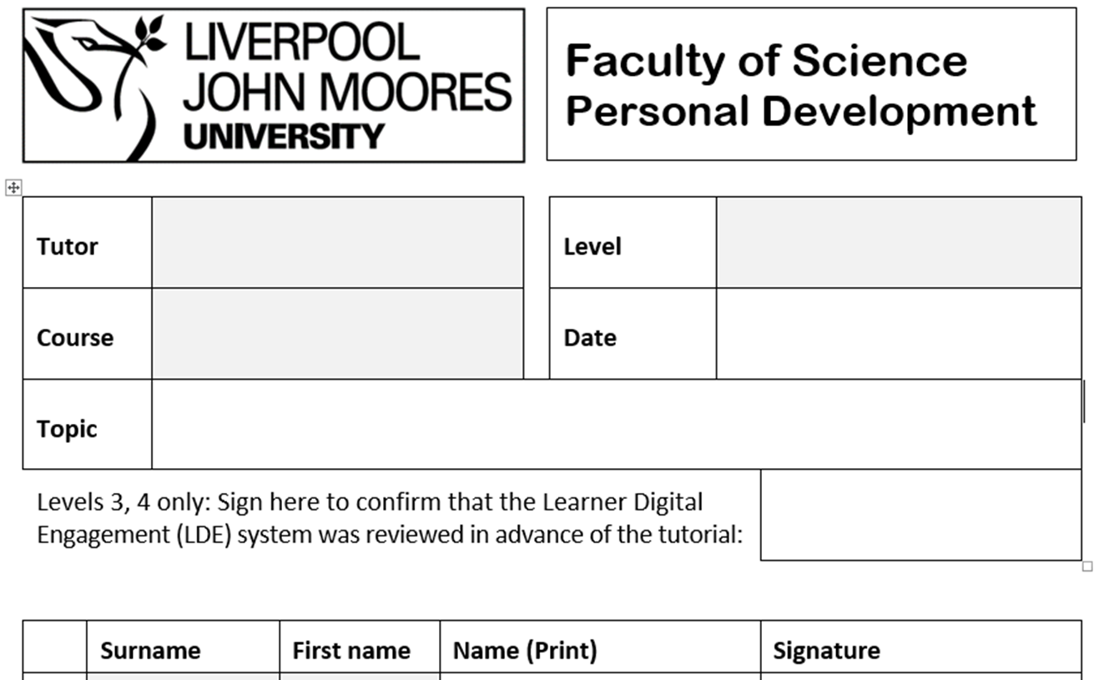
2. All L3/L4 personal tutors should sign tutorial registers to confirm that they have viewed LDE before each tutorial
Philip Denton
4
Chemistry
31/10/19
4001 calcs

Slide 10
See My Tutor: availability advertising
Advertising four hours of availability per week for ad hoc meetings with students remains but displaying availabilities on a poster will end, because…
SeeMyTutor to be used exclusively by all staff when advertising availability. Video help guide via:
Clipframe posters by doors will now be static and display:
Staff name, role, contact details and colour photo
Link to SeeMyTutor
Poster template available. Here’s one I prepared earlier…

Slide 11
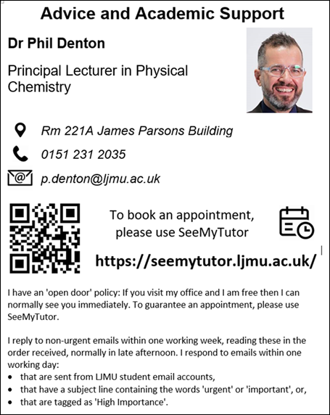

Slide 12
Thank you
Phil Denton
p.denton@ljmu.ac.uk
Associate Dean (Education)
Faculty of Science

