Slide 1
Faculty Learning, Teaching and Assessment (LTA) Update Winter 2022
Phil Denton
p.denton@ljmu.ac.uk
Associate Dean, Education and Student Experience (ADESE)
Faculty of Science
Presented: PBS 15/12/22

Slide 2
Contemporary information
Talking about Teaching 2022/23
The Faculty’s Peer Review Scheme.
Semester 2 arrangements being finalised.
Surveys
NSS opens January. School NSS Champions have been attending networking meetings.
PTES opens March. Faculty prize draw incentive.
Alternative (to exam) assessments 2022/23
These require formal approval if made permanent and contradict the module proforma.
Submit via CourseLoop.
Personal tutoring review

Slide 3
OfS Student Outcomes Regulation
Exclusively outcomes based.
Uses last four-years’ data, split across 28 Subject Areas at LJMU.
Baselines for the entire Sector:
Continuation: Still enrolled one year and 15 days after start.
Completion: HE qualification 4 years and 15 days after start.
Progression: Highly-skilled employment or further study 15 months after award of HE qualification.
“Breaches” will lead to:
Improvement notice → financial penalty → deregistration

Slide 4
Teaching Excellence Framework
TEF relates to undergraduate students only.
Applies institution- and subject-specific benchmarks to existing quantitative data, alongside an institutional narrative.
Performance outside +/- 2.5% of benchmark is flagged.
Student Experience measured via NSS scores (Teaching, Assessment & Feedback, Support, Resources, Student Voice)
Student Outcomes measured using the same data as OfS scheme, but with benchmarks, not baselines, applied.
Data also split by mode of study, disability, ethnicity, deprivation (IMD), age, domicile, and sex.
Ultimate institutional TEF rating (gold, silver, bronze, unrated) linked to fees that may be charged.

Slide 5
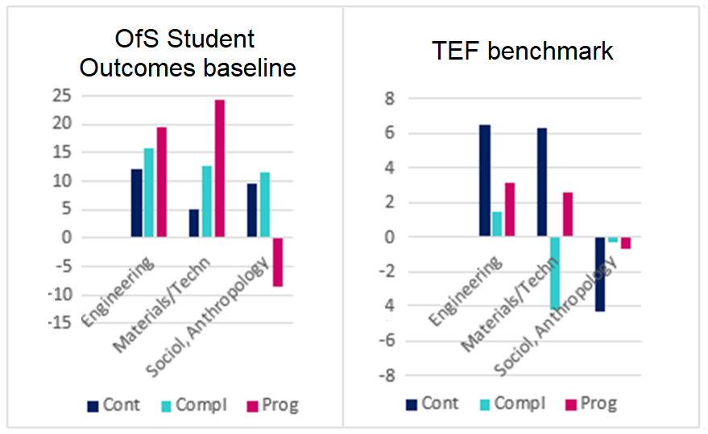
Thresholds versus benchmarks
FT UG First Degree: Examples

Slide 6
Thank you
Phil Denton
p.denton@ljmu.ac.uk
Associate Dean, Education and Student Experience (ADESE)
Faculty of Science

