Slide 1
Faculty Learning, Teaching and Assessment (LTA) Update Spring/Summer 2022
Phil Denton
p.denton@ljmu.ac.uk
Associate Dean, Education (ADE)
Faculty of Science
Presented: PBS 19/5/22

Slide 2
Contemporary information
Zoom depreciation
MS Teams for teaching from Sept 2022
Courseloop
New course management system replaces Mod/Prodcat
Training from early July
Demonstration at the Students at the Heart Conference
Postgraduate Teaching Experience Survey
Faculty-funded prize draw (six £50 Amazon vouchers)
Current response rate 27%, closes mid June
LearnSci Laboratory Simulations
FMT have approved funding for 2022/23

Slide 3
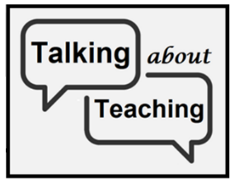
LJMU Teaching quality scheme
Agreed 2022 by Executive Leadership Team and has 3 parts:
Teaching Observation (restarts Sept 22)
Module Evaluation
Peer review
Talking about teaching is the Faculty’s name for peer review
“a formalised and substantive conversation between academics, dedicated to exploring an identified theme within educational practice that is not a part of their other scheduled obligations.”
Overseen locally by Subject Leads.
Staff should register they participation via the online form by Tuesday 31st May.

Slide 4
