Slide 1
Faculty Learning, Teaching and Assessment (LTA) Update Semester 2 2018/19
Phil Denton
p.denton@ljmu.ac.uk
Associate Dean (Education)
Faculty of Science
Presented: NSP 16/1/19

Slide 2
Ongoing Activities: Updates
LTA website: Redesigned with separate section for employability resources
Teaching observation: 107 Scheduled observations in the Faculty this year, 26 completed @15/1/19. Remaining 81 staff will be invited to confirm the scheduled observation date via online survey. Deadline for all forms is 18/4/19.
Student photos in Outlook: 2018/19 photos pending as development is problematic, as usual.
LJMU LTA Awards: SMT-agreed recommendations received and to be shortlisted in mid February.
School Research and Practice in HE seminars discontinued: Multi-date Faculty LTA events favoured in future.

Slide 3
New activities: Updates
Faculty
Transportation arrangements for Faculty Nexus Pads (for in-class survey completion) to be reviewed.
50 USB Microphones (for Panopto) and 16 additional PowerPoint controllers purchased: Email me to request.
Seating plans for Marybone LT: Pilot this semester.
Slider signs on IT Suites: When you
leave the scene, return to green.
University’s Skills@LJMU webpages updated: Rosetta Stone language tuition and Skills4Campus available.
Walkabout Week to return: Casual teaching observation in Week 23; details via Ab stract

Slide 4
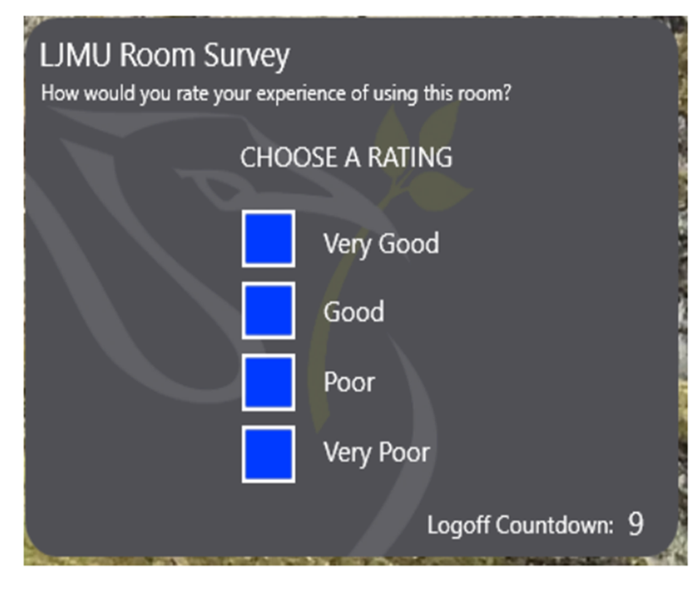
New activities: Updates
University
PVC (Education) Roadshow: 1/4/19, 15h-14h, P.Jost Lower
Module evaluation weeks 26 & 27 (18-29 Mar): Schedule in-class survey completion by booking the Nexus Pads.
Meetoo guidance reinforced: Turn on moderation
SeeMyTutor reached 3000 appointments by November
BS/103, BS/301 and P.Jost Lower
earmarked for refurbishment.
Rate my Room (by staff at log off)
Rooms rated very poor will
be chased up but use helpdesk,
AVA-Byrom, or Estates as usual.

Slide 5
New activities: Updates
National:
^{l} Augar report into post-18 education funding reports later this year, plenty of leaks in the meantime...
Second year of the two-year subject-level TEF pilot: Staff are writing narratives for each of the subject areas.
Weightings of the TEF pilot metric data types (likely to be adopted in full roll-out):
NSS (33%)
Employability (40%)
Retention (27%)

Slide 6
Any Questions?
Phil Denton
p.denton@ljmu.ac.uk
Associate Dean (Education)
Faculty of Science

