Slide 1

Science Teaching Interest Group
#03
6/3/2023

Slide 2
Brings together colleagues from within the Faculty to discuss matters of contemporary interest relating to teaching, learning and assessment.
Sits outside our deliberative structures and so nothing is off the table.
Feeds into decision-making by Faculty Education Committee and FMT.
Brings together colleagues with an established interest in teaching who had no previous opportunity to gather:
• PGCert/CAP Observers
• LJMU Teaching Award Winners
• NSS Champions
• National Teaching Fellows
• School LTA Coordinators

Slide 3
LJMU Strategy 2030
Two Principles: Priority of people and Sustainability
Four Enablers: Positive Culture, Organisational Responsiveness, Financial Resilience and Digital and Physical Infrastructure.
Three Aims:
  Place and Partnership
  Research and Knowledge Exchange
  Education and Student Experience

Slide 4
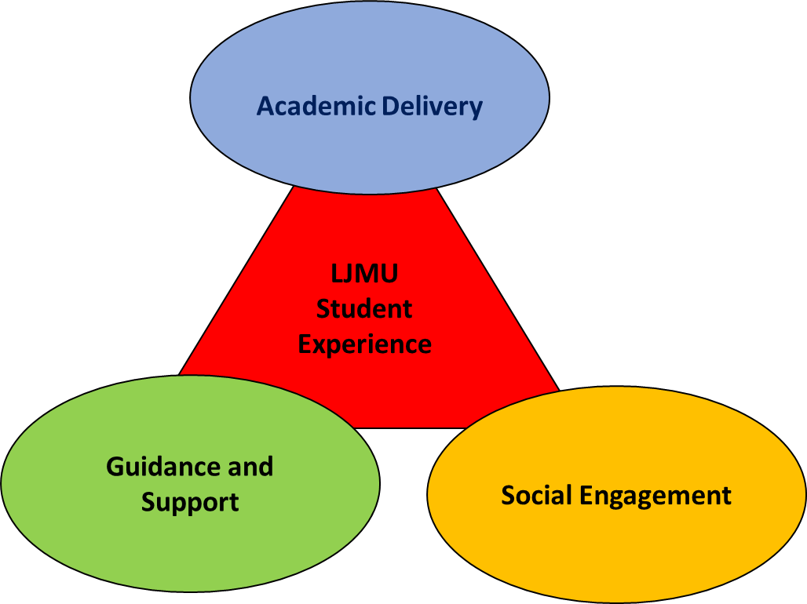
Education and Student Experience Strategy 2023-2030

Slide 5
