Slide 1
SCS Overall Satisfaction Trends

Slide 2
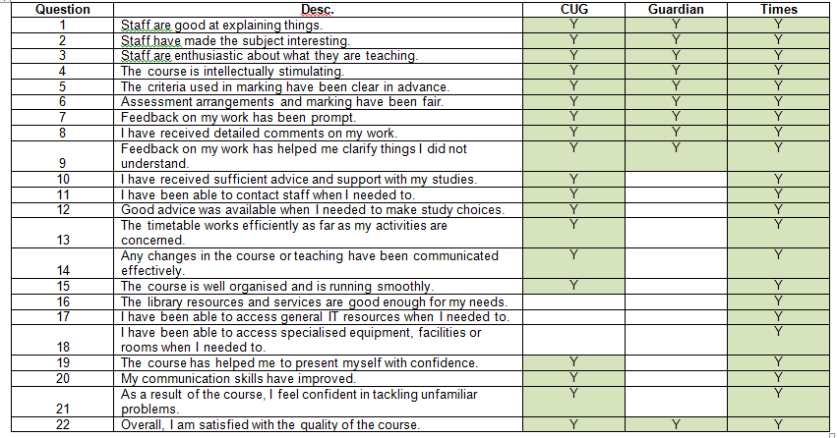
NSS and League Tables
CUG = Complete University Guide

Slide 10
NSS Free text comments
Circulated to School Directors for dissemination.
Semantic analysis for each School’s comments shared with programme leaders.
Some overall themes:
  LJMU/University is a new favourable concept.
  Communication is no longer an unfavourable concept.
  ‘Teaching on my course’ rated by students as highly as their least-favoured taught session/module.
  Complaints over reading-off slides, 3 hr lecture blocks, session cancellations, unchecked poor student behaviour.
  Exposure to research always viewed positively.

Slide 11
Actions
Assessment and Feedback: Using language of NSS, clarity over set/due dates.
Academic support: 4 hours advertised availability (clip frames still to be installed)
School Directors’ Action Plans.
Engagement with NSS Champions Forum, SCS Reps:
  Jason Kirby
  Shaqil Chaudary
  Mark Scott

