Slide 1
Learning, Teaching and Assessment Update
Phil Denton, Associate Dean (Education and Student Experience)
Faculty Forum
Mon 19 June

Slide 2

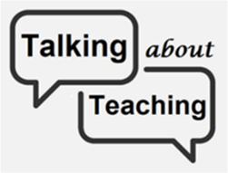








2022/23

Slide 3


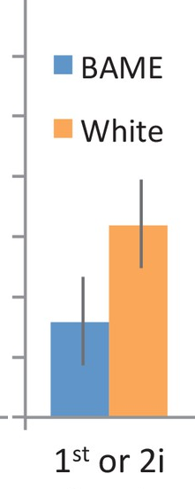




2023/24
Student outcomes: Baselines
The TEF: Benchmarks

