Slide 1
Teaching Excellence
Framework - TEF
Faculty Forum, June 2017
Elaine Hemers, Associate Dean (Quality)
Phil Denton, Associate Dean (Education)

Slide 2
Teaching Excellence Framework - TEF
TEF = Government-administrated evaluation of universities’ ‘performance’.
Compared to newspaper league tables…
Research has no bearing on the outcomes.
Students’ entry grades are not used as a quality measure.
Judgements on performance are relative to benchmarks.

Slide 3
Teaching Excellence Framework - TEF
Where are we now?
Higher Education and Research Act (2017) establishes new regulator and funding council for universities, Office for Students (OfS).
OfS administers TEF: Outcomes for 342 HE providers will be published on Thursday 22nd June. Includes; LJMU, UoL, LIPA, Liverpool School of Tropical Medicine, Hope, City of Liverpool College
Expected to challenge traditional hierarchies shaped by newspaper league tables
Notes:
OfS replaces HEFCE, QAA and OFA (office for fair access).

Slide 4
Teaching Excellence Framework - TEF
TEF – Year 1 (2016/17)
Entry to TEF – Year 1 is voluntary.
Outcome features only one judgement level: “Meets Expectations”.
Awarded to any HEI with a successful QA award.
LJMU’s recent QAA HE Review outcome secured TEF-Year 1.

Slide 5
Teaching Excellence Framework - TEF
TEF – Year 2 (2017/18)
Is a trial year; operates at provider level, again on a voluntary basis.
Three possible judgements for main provision:
Meets Expectations [Bronze]
Excellent [Silver]
Outstanding [Gold]
No financial differentiation between the possible outcomes; clear reputational impact.

Slide 6
Teaching Excellence Framework - TEF
TEF beyond 2018/19
OfS will designate an independent body to carry out its duties, including administration of TEF.
TEF to be reviewed independently in 2019.
Expectations:
Tuition fees to increase by the rate of inflation until 2020 for TEF institutions.
After 2020, tuition fees may be linked to results in the TEF.
Subject-level TEF & PGT to be added.
Notes:
Might expect the QAA to take over TEF

Slide 7
Teaching Excellence Framework - TEF
TEF – Year 2
Six Core Metrics
Teaching on my Course [NSS]
Assessment & Feedback [NSS]
Academic Support [NSS]
Non-continuation [HESA]
Employment & Further Study [DLHE]
Highly Skilled Employment & Further Study [DLHE]
15 page narrative with contextual information
Notes:
Paste in 5 questions from NSS
The teaching on my course
1. Staff are good at explaining things.
2. Staff have made the subject interesting.
3. Staff are enthusiastic about what they are teaching.
4. The course is intellectually stimulating.
Assessment and feedback
5. The criteria used in marking have been clear in advance.
6. Assessment arrangements and marking have been fair.
7. Feedback on my work has been prompt.
8. I have received detailed comments on my work.
9. Feedback on my work has helped me clarify things I did not understand.
Academic support
10. I have received sufficient advice and support with my studies.
11. I have been able to contact staff when I needed to.
12. Good advice was available when I needed to make study choices.
Professional and managerial in DHLE is highly skilled in TEF = healthy PGT provision.

Slide 8
Teaching Excellence Framework - TEF
TEF – Scoring
Considers performance over last 3 years relative to a benchmark; a weighted sector average based on the provider’s students (e.g. age, ethnicity, subject).
Flags for each metric:
Flag | Performance compared to benchmark
+ + | ≥ 3%
+ | ≥ 2%
 | > -2% and < 2%
- | ≤ -2%
- - | ≤ -3%

Slide 9
Teaching Excellence Framework - TEF

Slide 10
Teaching Excellence Framework - TEF
TEF – Year 2 Assessment
“A provider with three or more positive flags (either + or ++) and no negative flags (either - or - - ) should be considered initially as Gold.
A provider with two or more negative flags should be considered initially as Bronze, regardless of the number of positive flags.
All other providers, including those with no flags at all, should be considered initially as Silver.”
TEF assessment panel will decide final outcome after reviewing flags and the 15-page narrative statement.

Slide 11
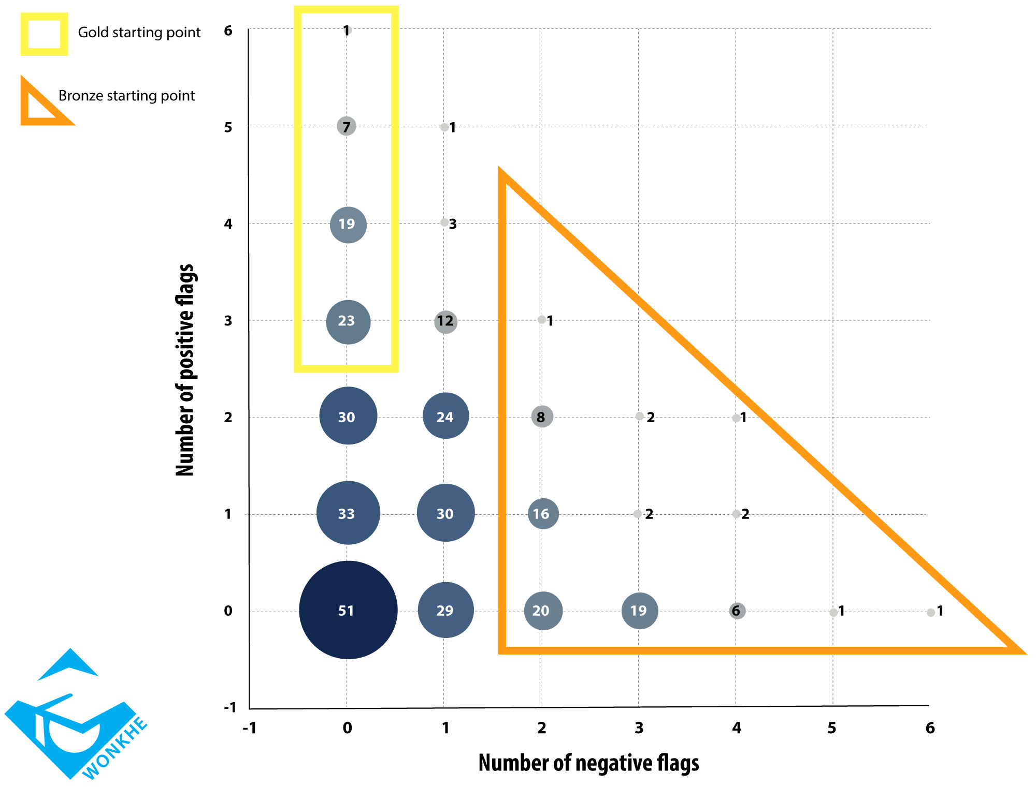
WonkHE
prediction:
50 Gold
213 Silver
79 Bronze
LJMU

Slide 12
Questions?

