Slide 1
Philip Denton Associate Dean, Education and Student Experience Faculty of Science
Faculty of Science School Meetings September 2023
Assessment in the AI era
Part 1: Context and Compass
Jim Turner Senior Learning Technology Developer
Teaching and Learning Academy

Slide 2
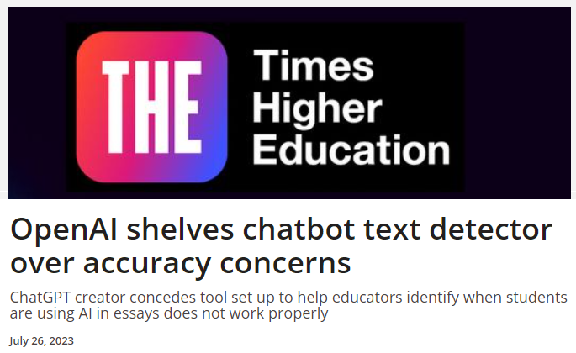
What are the challenges for university assessment in an era of Artificial Intelligence?
Assessing students in the era of Artificial Intelligence (AI) presents several challenges and opportunities for universities.
Here are some of the key challenges:
Maintaining Academic Integrity: With the increasing availability of AI tools, there is a risk of students using AI-powered tools to cheat on assignments and exams. Universities must find ways to detect and prevent cheating while still allowing for the responsible use of AI in education.
Designing Fair and Bias-Free Assessments: AI algorithms can inadvertently introduce bias into assessments if they are not carefully designed and tested. It's crucial to ensure that AI-driven assessments are fair to all students, regardless of their background or demographic.
Data Privacy: The use of AI in assessment often involves collecting and analyzing large amounts of student data. Universities must prioritize data privacy and security to protect students' personal information.
Teacher Training: Faculty and staff may need training to effectively incorporate AI into assessments. This includes understanding how to create AI-driven assessments, interpret the results, and provide appropriate feedback to students.
Customization and Personalization: While AI can provide personalized feedback and assessments, it can be challenging to strike the right balance between customization and standardized assessment to ensure that all students are evaluated fairly.
Resource Constraints: Implementing AI in assessments may require significant financial and technical resources. Universities may struggle with budget limitations and the need to invest in AI infrastructure and expertise.
Lack of Access and Equity: Not all students have equal access to technology and AI tools. Universities must consider how AI assessments may exacerbate existing disparities in education.
Validation and Reliability: AI-driven assessments must be rigorously validated to ensure their reliability and effectiveness. This process can be time-consuming and resource-intensive.
Feedback Mechanisms: Developing AI systems that can provide meaningful feedback to students is challenging. It requires a deep understanding of pedagogy and subject matter expertise.
Ethical Considerations: Universities must navigate ethical questions surrounding the use of AI in assessment, such as the potential for bias, invasion of privacy, and the role of human judgment in education.
Despite these challenges, there are also significant opportunities for universities in the era of AI assessment…

Slide 3
Principles
Use of AI in education:
Support students and staff to become AI literate
Enable students to use AI tools responsibly and ethically
Adapt teaching and assessment to integrate AI and provide equal access
Maintain academic rigour and integrity
Collaborate to optimise practices as AI technologies evolve
https://russellgroup.ac.uk/news/new-principles-on-use-of-ai-in-education/ (8/9/23)

Slide 4
Our collective vision for education
Where are we now? | Where do we need to get to?
Level of staff and student understanding | Process for exploring, sharing and developing
Current assessment design | Review and change processes
Institutional rate of change | Highlight barriers for agility
Localised organisational structures | Create institutional processes for sharing developments
Incredibly dynamic environment: ChatGPT4, MS Edge Chatbot, MS co-pilot? | Process for monitoring development and instigating change where needed

Slide 5
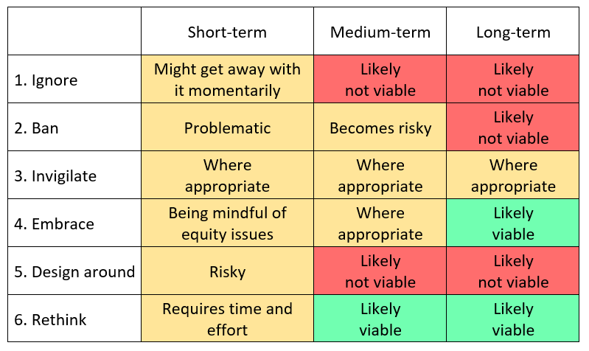
Adapting assessment
https://www.linkedin.com/pulse/assessment-redesign-generative-ai-taxonomy-options-viability-lodge/ (8/9/23)

Slide 6
Our approach to communicating AI permissions in assessment tasks:
N No AI tools may be used
S Some AI tools may be used and these will be specified
E Every AI tool may be used
W Ways in which AI may be used will be specified
Use or non-use is accompanied by an appropriate acknowledgement
https://www.ljmu.ac.uk/about-us/faculties/faculty-of-science/compass (8/9/23)
Outline permission presented in module assessment information on Canvas
Detailed permission presented in assignment information on Canvas
ITS are currently working on copy-to-clipboard functionality

Slide 7
Example
Intellectual Property (IP) Law: Every AI may be used
“The assessment this year takes into account generative AI. Rather than asking you to write an answer to the question, we have asked Claude 2 to produce the answer and then for you to critically evaluate it.”
Present an AI Acknowledgment prior to your references using the template below.
I acknowledge the use of [which] to [what] on [when]. The prompts used included: [how].

Slide 8
Summary
Staff understanding:
Engagement with AI tools and familiarity with the knowledge base, including LJMU guidance: AI Considerations
Organisational structures:
Module and Programme Teams, AI practice exchanges
Student understanding:
Reliability, accessibility, cognitive scaffolding vs offloading, clear assessment guidance: Compass

