Slide 1
Blended learning approaches to support the development of professional skills and identities
Anne Osterrieder (@AnneOsterrieder)
Oxford Brookes University
Liverpool John Moore University
18th April 2018

Slide 2
Blended Learning?
Face-to-face teaching
+
Online teaching
Substitution of instructional activities
Redefinition =
design of new activities
Boelens, R., De Wever B., Voet, M. (2017). Educational Research Review 22, pp 1-18

Slide 3
Let’s talk about ‘employability’…
Graduate Employability, University Rankings, LEO,TEF…

Slide 4
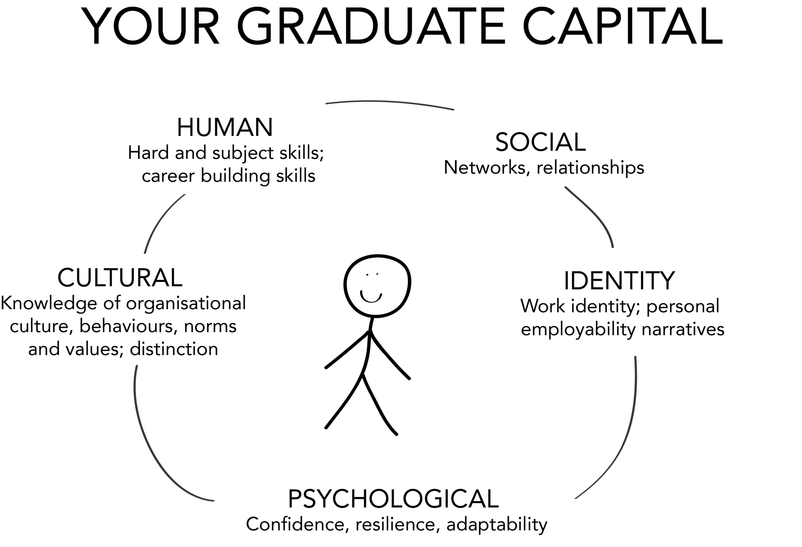
Based on Tomlinson, M. (2017) Education and Training, 59:4, pp 338-352.

Slide 5
How can I make my ‘Biotechnology’ students feel like networked professionals in their discipline - in a teaching room…
Based on Tomlinson, M. (2017) Education and Training, 59:4, pp 338-352.

Slide 6
Twitter!

Slide 7
Using Twitter in a module
Show students that what they are learning is very current (especially in biotech!)
Crowd-sourced reading materials
Building a learning community that extends beyond the classroom
Gaining confidence in curating a professional online profile
Chawinga, W. D. (2017). International Journal of Educational Technology in Higher Education 14:3. DOI 10.1186/s41239-017-0041-6

Slide 8
Some Twitter approaches
Lecturer = expert;
Students = consumers of information, non-experts
Module/course hashtag, module leader tweets information (#U14587)
Twitter as ‘backchannel’ for student questions
Students post links, engage in discussion with lecturer and other students, ask and answer questions
Students and lecturer = experts, collaborate

Slide 9
My approach

Slide 10
#Organellewars!

Slide 11
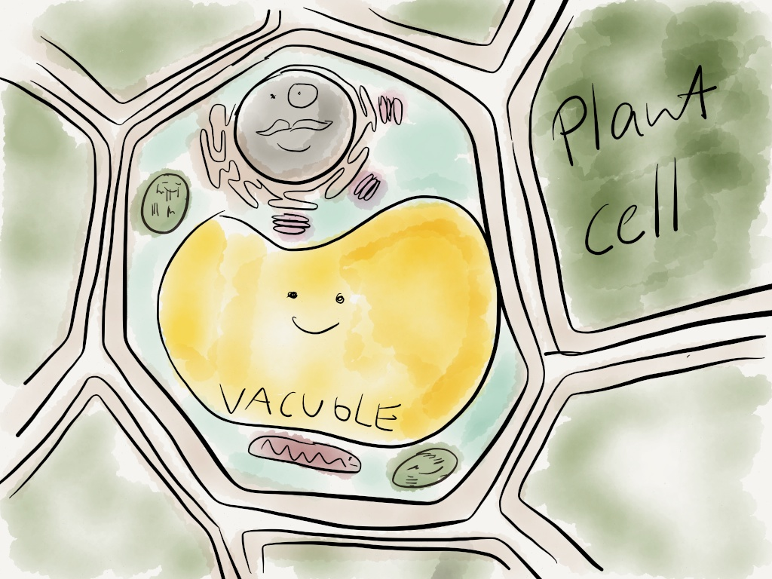

Slide 12
“Starting the Organellewars”, Brad Graba (@mr_graba): http://www.asbmb.org/asbmbtoday/201703/Education/

Slide 13
Organellewars
…is fun!
…has a specific focus and goal: design a presidential campaign for your organelle = creativity
…is run in small groups = collaboration
…is run as organelle accounts = anonymity (in this context: child safeguarding)

Slide 14
Twitter is very public, which can put people off using it for university queries. […]
"I'm not sure I'd feel comfortable discussing any queries or academic difficulties on social media. It forms a personal record that can be used to define you," says a history of medicine postgraduate student at UCL.
‘Universities should use Twitter to engage with students’, Maria Cross, Nov 2013, The Guardian. Available at: https://www.theguardian.com/education/mortarboard/2013/nov/22/universities-twitter-engage-with-students

Slide 15
Redesigning #organellewars for Higher education

Slide 16
Assignment brief (abridged) – part 1
“In a small group, you will create and curate a professional biotechnology-themed 'Twitter' account”
Creativity
Professionalism
Anonymity – not even I know who tweeted what

Slide 17
“What will we be marked on - how many followers we’ll have?!”

Slide 18
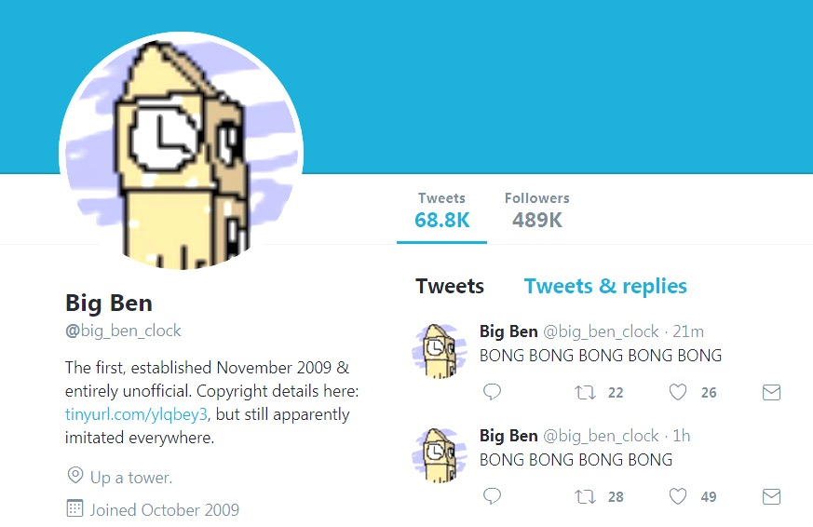

Slide 19
What makes a ‘good’ Twitter account? Student-sourced criteria
Regular constant feed
Variety of content, e.g. agriculture, laboratory-based science...
Multimedia
Re-tweeting others
Engage trending hashtags
Grammar, spelling

Slide 20
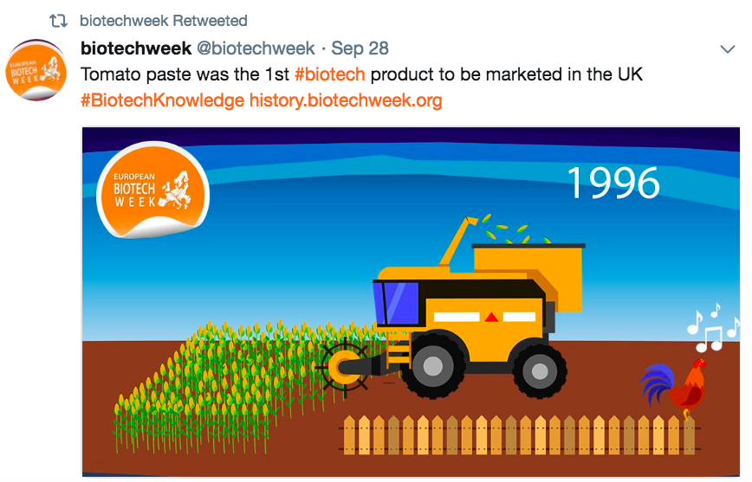
Assignment brief (abridged) – part 2
“Run a creative campaign for #BiologyWeek (7-15 October 2017) to engage non-experts with biotechnology. ”
(2015: #BiotechWeek)

Slide 21
What did the students do?
The ‘A – Z’ of Biotechnology, quizzes, podcasts
Asked followers and lecturers what Biotechnology meant to them, tweeted replies
Pretended to be a big company sending their interns to biotech sites across the UK, visited family farm and pond, took pictures of themselves, and posted pictures of their ‘interns’ on Twitter
Daily explanations of the ‘Colours of Biotechnology’

Slide 22
Final grade (worth 15% of module mark)
50% average group peer mark: Each group marks each of the other accounts
50% module leader mark for individual Twitter ‘portfolios’: screenshots of all tweets, submitted on Turnitin anonymously
Final grade weighted by student’s contribution to ‘content’, ‘presentation’ and ‘engagement’.
Deadline for portfolio submission: Week 9

Slide 23
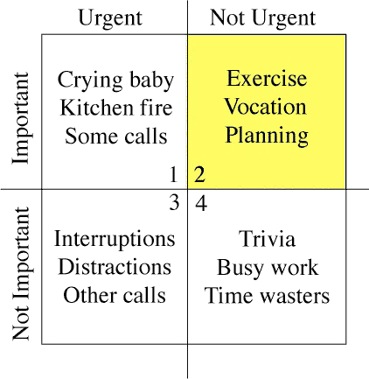
Tweeting for 8 weeks?!
By Rorybowman - Own work, Public Domain, https://commons.wikimedia.org/w/index.php?curid=2135450

Slide 24
Student feedback
Learning how to persistently do something over a long period of time
Sharing passion for science with like-minded people
Unusual skills to put on CV: science communication, social media

Slide 25
Impact?
Unexpected impact
Assignment helped students to keep up with reading over course of the module
Exam results and module averages were higher than for other modules
BUT! Due to:
Better learning retention?
Engaged students?
Generous marking?!
Better learning retention?
Engaged students?
Generous marking?!
The ‘European Biotech Week’ organisers approached two groups to write articles about their campaigns for their magazine – and were surprised they were students
Some student accounts came back to life after the end of the semester

Slide 26
Engaging students with professional values and ethical decision-making

Slide 27
‘Science and Ethics’ – a ‘blended’ approach
Before the seminar
Face-to-face:
Small groups meet to discuss topic and produce assessed one-page summary.
Online:
Individuals complete
e-learning activity.

Slide 28
A repurposed e-learning activity
Roff, S., Chandratilake, M., McAleer, S. and Gibson, J. (2012). "Medical student rankings of proposed sanction for unprofessional behaviours relating to academic integrity: Results from a Scottish medical school." Scott Med J 57(2): 76-79.
Lloyd-Jones, N., Mills, K., Dalrymple, R. and Roff, S. (unpublished). "Promoting student engagement with the concept of professionalism in practice: An emerging pedagogic strategy."

Slide 29
24 unprofessional scenarios…
Removing an assigned reference book from a shelf in the library.
Signing attendance sheets for absent friends.
Fabricating data from scratch.
Altering or manipulating data.
Making an honest but serious mistake in reporting research results.
Not doing the part assigned to you in group work or assessment.

Slide 30
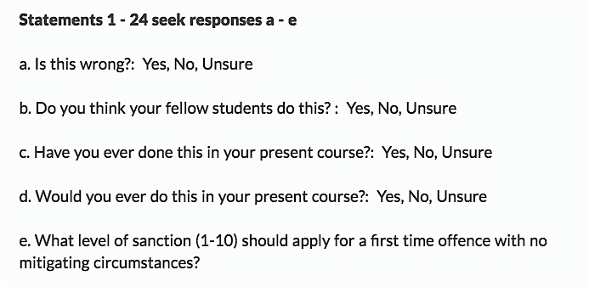

Slide 31
‘Science and Ethics’ – a ‘blended’ approach
Before the seminar
Seminar
Discuss values, examples of misconduct, impact on science and society.
Discuss results of e-learning activity.
Face-to-face:
Small groups meet to discuss topic and produce assessed one-page summary.
Online:
Individuals complete
e-learning activity.

Slide 32
Altering or manipulating data…
…everyone else is doing it…

Slide 33
Altering or manipulating data…

Slide 34
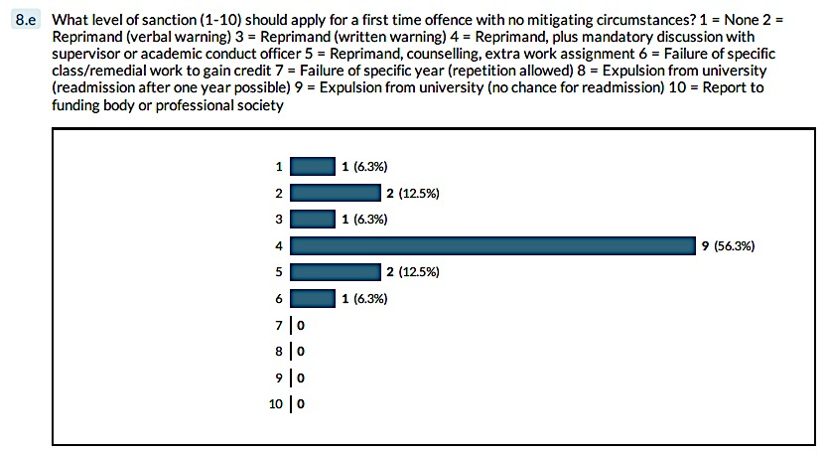
Altering or manipulating data…

Slide 35
‘Surely this is common sense…’
‘This’ being:
Not to fabricate or manipulate data, plagiarise, not credit others…
How unprofessional or unethical behaviour is sanctioned – should be sanctioned?

Slide 36
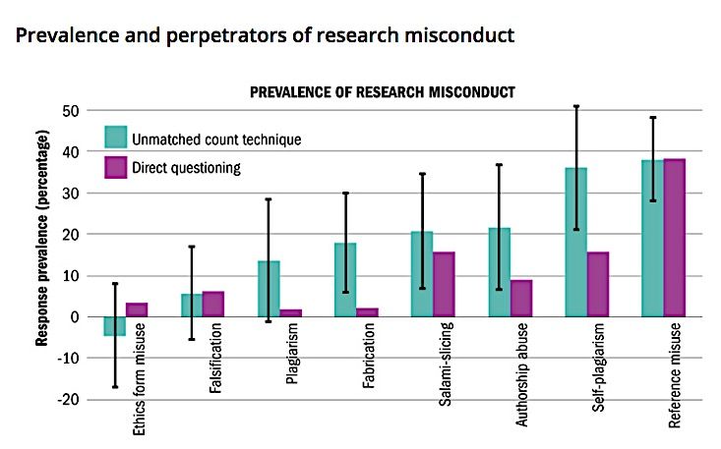
Williams and Roberts, Times Higher Education, June 30, 2016: https://www.timeshighereducation.com/features/is-there-a-problem-with-academic-integrity

Slide 37
In this room…?!

Slide 38
What’s next?
Publishing examples as case studies
Diving deeper into ‘proper’ pedagogy: mapping students’ experiences onto the Graduate Capital Model, in collaboration with Michael Tomlinson, Southampton University
Oxford Brookes Teaching Excellence Fellowship Year 2
THANK YOU
@AnneOsterrieder

Slide 40
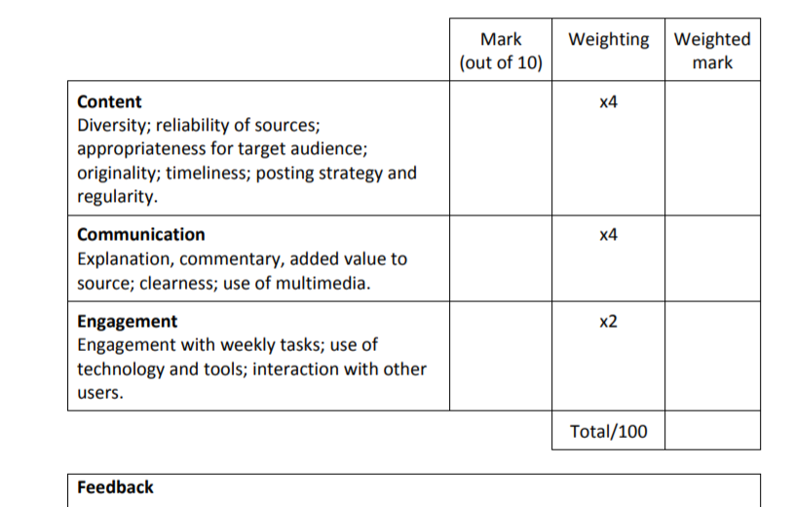
Marking pro forma

