Slide 1
Student Intern Summer Project (for Chemistry for All Programme) SCS LTA Development Day 15 December 2014
Ian Bradshaw and Linda Seton
School of Pharmacy and Biomolecular Sciences

Slide 2
Contents
Overview of the Summer Curriculum Enhancement Student Internships
Introduction to Chemistry for All (CfA) Project
Aims of the Student Intern Project
Operation and Management of the Student Intern Project
Project Outcomes
Benefits of the Student Intern Project
Expected changes to the Scheme for 2015
Acknowledgements

Slide 3
Overview of Summer Curriculum
Enhancement Student Internships
Notes:
Joe – Our chemical sciences and education internship lasted for 10 weeks, running from June to September. Although this was one of the longest internships, we needed the time to fully prepare and test the activities we had devised, ensuring the highest standard was produced. We worked alongside Dr. Ian Bradshaw, Dr. Linda Seton, Dr. Andrea Mallaburn and Paul Ireland who have all been extremely supportive throughout this time, offering their expertise and experiences to further improve our work.
Lisa – The Chemistry for All project is a five year national programme funded by the Royal Society of Chemistry and has the ultimate aim of increasing students understanding of Chemistry and providing motivation to learn it or even follow a career with it. We have devised a range of activities and experiments mainly for year 8 students, but have also produced materials for year 9 as well.

Slide 4
Overview
Funded from Office of Vice Chancellor and Pro-Vice Chancellor (Education)
Expectation that projects would have an output in terms of curriculum enhancement and student experience
Competitive process to apply for Student Internships
Trial phase of 17 projects across the University funded in 2014
Student intern was an LJMU employee for the duration of the project
Length of the projects varied between 4-10 weeks
Induction and Feedback process
Notes:
Joe – Our chemical sciences and education internship lasted for 10 weeks, running from June to September. Although this was one of the longest internships, we needed the time to fully prepare and test the activities we had devised, ensuring the highest standard was produced. We worked alongside Dr. Ian Bradshaw, Dr. Linda Seton, Dr. Andrea Mallaburn and Paul Ireland who have all been extremely supportive throughout this time, offering their expertise and experiences to further improve our work.
Lisa – The Chemistry for All project is a five year national programme funded by the Royal Society of Chemistry and has the ultimate aim of increasing students understanding of Chemistry and providing motivation to learn it or even follow a career with it. We have devised a range of activities and experiments mainly for year 8 students, but have also produced materials for year 9 as well.

Slide 5
Introduction to the Chemistry for All (CfA) Project
Notes:
Joe – Our chemical sciences and education internship lasted for 10 weeks, running from June to September. Although this was one of the longest internships, we needed the time to fully prepare and test the activities we had devised, ensuring the highest standard was produced. We worked alongside Dr. Ian Bradshaw, Dr. Linda Seton, Dr. Andrea Mallaburn and Paul Ireland who have all been extremely supportive throughout this time, offering their expertise and experiences to further improve our work.
Lisa – The Chemistry for All project is a five year national programme funded by the Royal Society of Chemistry and has the ultimate aim of increasing students understanding of Chemistry and providing motivation to learn it or even follow a career with it. We have devised a range of activities and experiments mainly for year 8 students, but have also produced materials for year 9 as well.

Slide 6
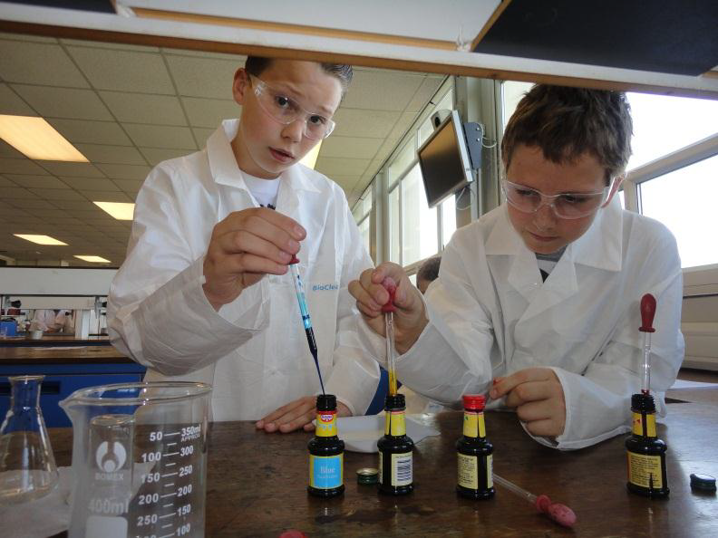
Introduction
Five year National Programme funded (£1 million) by the Royal Society of Chemistry
LJMU CfA team will be working with Chemistry Departments in Four other HE institutions to deliver Chemistry Outreach Activities in selected schools
A team from the Institute of Education are carrying out the social science research to explore the barriers to a more representative undergraduate Chemistry population
The longitudinal nature is a unique feature of the project

Slide 7
Introduction
A cross University project involving two School (PBS, TEPL) and a Professional Services Team (Student Recruitment and Admissions)
LJMU CfA team will be working with six local schools to provide stimulating interventions in Chemistry for pupils to raise their motivation and aspirations
We had devised a programme of planned activities and experiments for the Year 8-12 cohorts of pupils in the CfA project
We had not yet developed the resources or fully tested the activities for the first year of the CfA programme that started in September 2014

Slide 8
Aims of the Student Intern Project
The student interns were asked to develop and test a range of Chemistry related activities and associated resources which were to be used in the delivery of the CfA programme

Slide 9
Operation and Management
of the Student Intern Project

Slide 10
Operation and Management
Project involved two student internships of 10 weeks duration
Student interns were selected by a competitive and discerning process
The student interns were given an initial induction with our team
Regular weekly team meetings and 1:1 meetings were held with the student interns
Regular email contact was maintained
Feedback to student interns on progress was delivered by a mixture of face-to face meetings and via email
The interns were exposed to as wide an experience within the University as possible

Slide 11
Project Outcomes

Slide 12
Project Outcomes
Devised and tested Chemistry related experiments and activities
In accordance with National Curriculum, STEM club and CREST awards
Practical scripts and workbooks
Risk Assessments
Notes:
Over the course of the internship, we developed a range of resources for the CfA students. We first devised the experiments, using examples from the RSC website and other trusted sources, and then tested them in the laboratory to ensure they worked and were also suitable for the age group. Examples of some fun experiments are elephant’s toothpaste, where we mixed hydrogen peroxide and yeast with some food colouring to produce a foam explosion. Classroom based activities were also designed, such as knowledge checks, quizzes, games and supporting information for the practical work. Each activity was designed in accordance with the Chemistry national curriculum, in order to ensure that the students were getting the required input and that the experiments and activities were not only fun and engaging, but relevant to their studies and skill level. A bulk of resources were made for STEM clubs and CREST awards, including a variety of topics such as Forensics, Pharmacy and Cooking. The aim here was to boost extra curricular engagement and further enhance the students ability to learn and understand Chemistry and wider scientific subjects. After each experiment was approved, a workbook or practical script was made to accompany the task. These included helpful instructions for the students as well as some interactive activities such as knowledge checks, drawing diagrams and learning new words. There was also guidelines for further work that could be completed at home to further the students understanding of the topic. Finally, all the materials were produced in line with the risk assessments COSHH and CLEAPPS, with the appropriate forms being made for each activity.

Slide 13
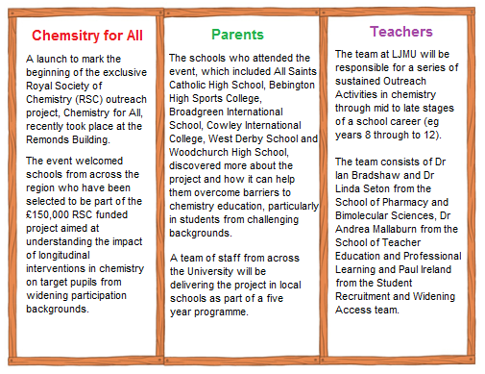
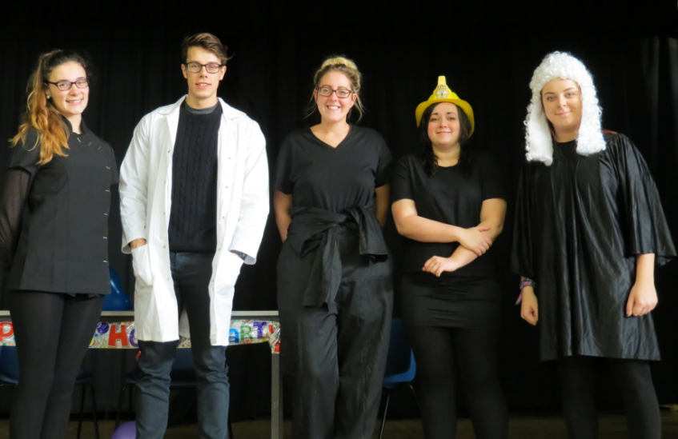
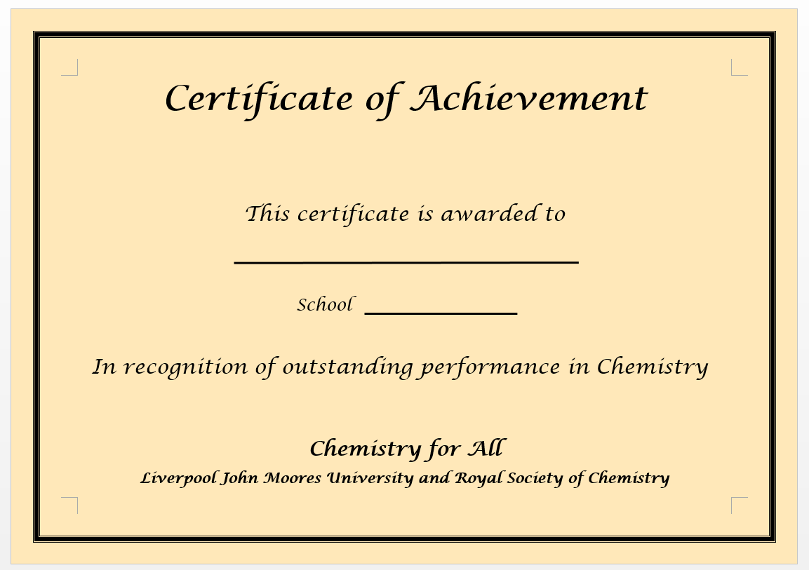
Project Outcomes
Drama production
Publicity materials
Scientist of the year competition
Web based resources - including videos of basic lab skills Measuring a Volume of Liquid
Notes:
We also produced materials that were more interactive and independent rather than being undertaken in a classroom or laboratory. A drama production was devised, including the plot, script and list of props. The play was based on Chemistry in everyday life, and an emphasis was placed on how studying Chemistry can be useful no matter what career or ambition you want to follow. So far the play has been a success, and the drama students have used their valuable input on adapting the play and incorporating some memorable Chemistry songs. A whole host of resources were created for the CfA website, with the intention of the students using the website to further their knowledge and engage with some extra-curricular activities. Materials included follow up tasks from an experiment they had recently completed, quizzes, wordsearches, element of the week, information on real life scientists and Chemistry in Merseyside and also some videos of basic lab skills CLICK LINK. Publicity materials such as leaflets and posters were also devised, mostly for parents, teachers and stake holders to inform them about the CfA programme and how it will benefit the students. Finally, an engaging and encouraging event was produced known as the Scientist of the Year competition. This involved the students receiving a number of merit cards for their good behaviour or proactive attitude in class for example, and then their names would be entered into a raffle at the end of the year. There would be an award for the student with the most merits and the student who showed outstanding performance. This was a way to encourage students to get more involved with activities, including STEM clubs and CREST awards and ultimately achieve more by participating and working hard.

Slide 14
Benefits of the Student Intern Project

Slide 15
Benefits for the Interns
WORK EXPERIENCE
TEAM WORK
COMMUNICATION
PROFESSIONALISM
PRACTICAL BASED
WEB DESIGN
RISK ASSESSING
WORKING WITH YOUNG PEOPLE
Notes:
Myself and the other intern Joe have gained our own benefits over the summer. We have gained some real work experience and have increased our employability skills for the future. We have also gained good communication skills, working with other colleagues and attending meetings with faculty staff. This has also helped us work as part of a team and improve our professionalism at work. We have also developed practical based skills, working in the laboratory on a weekly basis and even learning about web design. We have learnt how to conduct in depth risk assessments, but something we can take away that not many other internships have offered is the opportunity to work with young people and help the next generation.

Slide 16
Benefits to Academic Staff
The student interns produced work of a sufficient standard to be used for the CfA programme
The quantity, quality and level of the work produced easily surpassed our expectations
The output of work could not have been achieved by the academic staff alone in the timescale
The student interns gave a different insight and alternative view to our overall project
Notes:
Joe – Our chemical sciences and education internship lasted for 10 weeks, running from June to September. Although this was one of the longest internships, we needed the time to fully prepare and test the activities we had devised, ensuring the highest standard was produced. We worked alongside Dr. Ian Bradshaw, Dr. Linda Seton, Dr. Andrea Mallaburn and Paul Ireland who have all been extremely supportive throughout this time, offering their expertise and experiences to further improve our work.
Lisa – The Chemistry for All project is a five year national programme funded by the Royal Society of Chemistry and has the ultimate aim of increasing students understanding of Chemistry and providing motivation to learn it or even follow a career with it. We have devised a range of activities and experiments mainly for year 8 students, but have also produced materials for year 9 as well.

Slide 17
Benefits to University
The projects provide a great opportunity to support academic staff in their work
The projects can enhance the academic experience and employability for students
Potential for a positive contribution to student-staff partnership/engagement at LJMU
Opportunity for cross University networking

Slide 18
Expected Changes for 2015

Slide 19
Expected Changes for 2015
Extended application and recruitment period
Additional guidance for staff and students
Extended induction and support processes
Development of webpages and mechanisms for dissemination

Slide 20
Acknowledgements
University Funding
Student Interns (Lisa Miller, L5 Forensic Science ; Joe Gayner, L5 MPharm)
CfA Team (Dr Andrea Mallaburn, TEPL ; Paul Ireland, Student Recruitment and Admissions)

Slide 21
Any Questions

