Slide 1
Faculty of Science 3rd Annual Learning, Teaching and Assessment Development Event Thursday 5th January 2017 Analysis Tools in Education Welcome: Phil Denton, Associate Dean (Education)

Slide 2
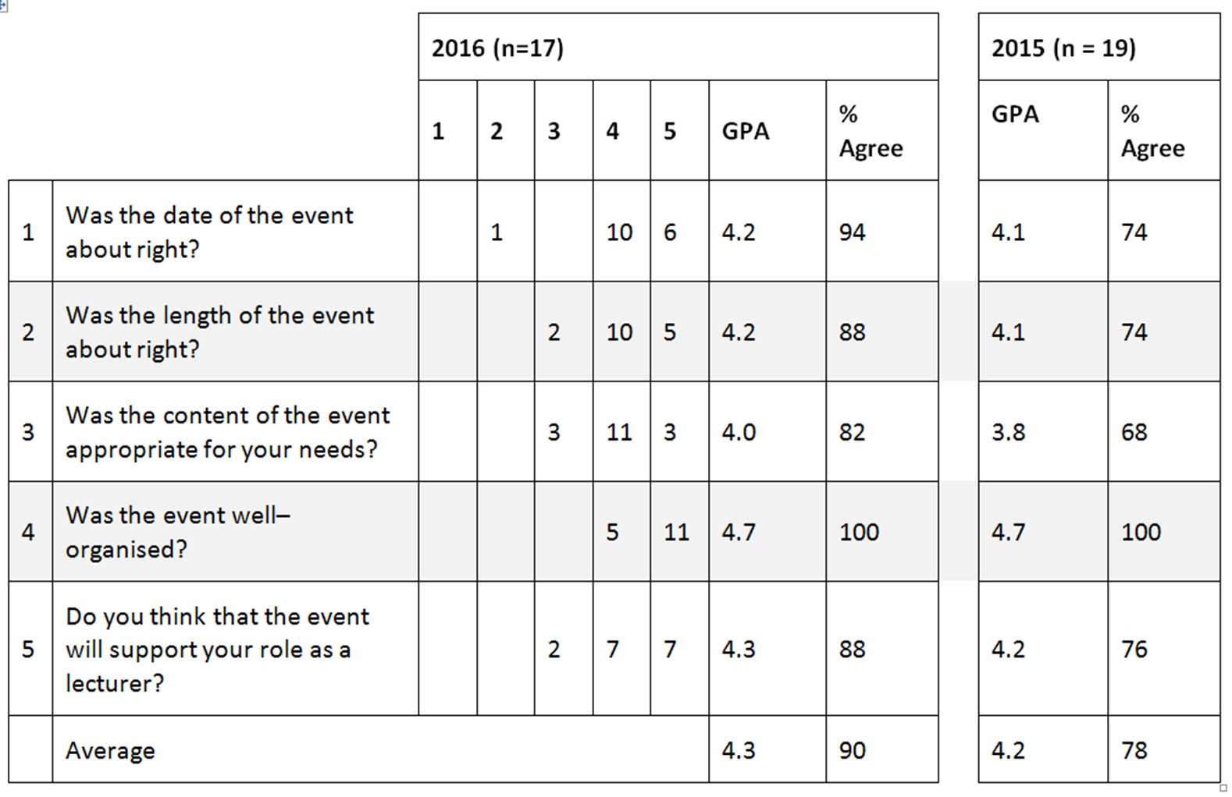
Feedback from last year’s event

Slide 3
Feedback from last year’s event
Provide more opportunities for discussion.
Over-arching themes/changes coming up.
Interactivity after lunch.
‘How to’ guides (step-by-step), not just outcomes.
Hidden (little-known) parts of Blackboard.
Food was excellent.
Very good – lunch was lovely.
Great lunch!

Slide 4
2017 Activities
Teaching Observation: 19 out of 116 observation completed to date
Abstract: The LTA Newsletter of the Faculty of Science
Textwall
Printing student names on lab coats
Student photographs in Outlook
Presentation Clickers
Samson UB1 Microphones for use with Panopto

