Slide 1
Netlogo
Using agent-based models in teaching,
even if you are a beginner
Will Swaney - NSP

Slide 2
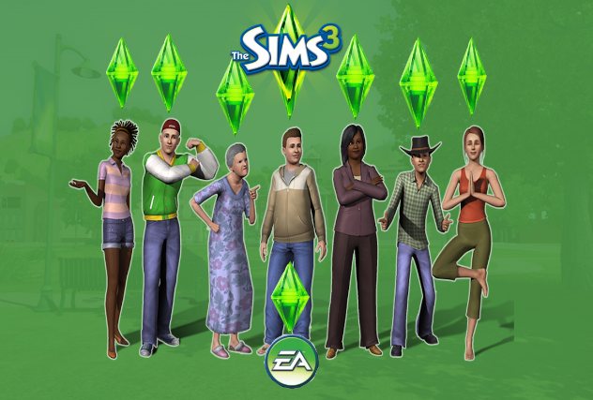
What is an agent based model?
Simulation of a system involving 'agents': virtual entities that obey defined rules and which can interact with each other
Can be used (in theory) to model any complex system
Has applications in research, education, and elsewhere:

Slide 3
What is NetLogo
Simple programming environment for agent-based models
Originally written by Uri Wilensky at Northwestern University in 1999, now up to version 6.0
Can be downloaded free of charge from http://ccl.northwestern.edu/netlogo for Windows, Mac OS, Linux
Lots of support etc can be found here too
Version 5.3 currently installed on AppPlayer (to be updated soon)

Slide 4
What is a NetLogo model like?
A visible model that you can observe as the simulation runs
An infinite 2D square environment
Agents – AKA ‘turtles’
A running clock – with each ‘tick’, the turtles carry out their instructions (move, turn, die, reproduce etc.)
Over successive ticks, the impact of different instructions on the agents emerge

Slide 5
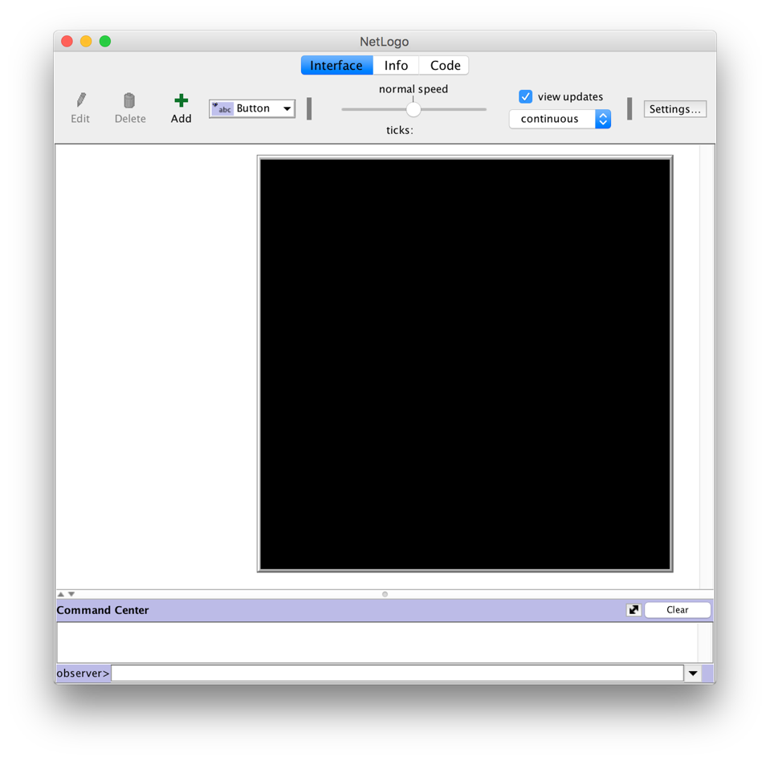
The basic NetLogo environment

Slide 6
An example of a complex system

Slide 7
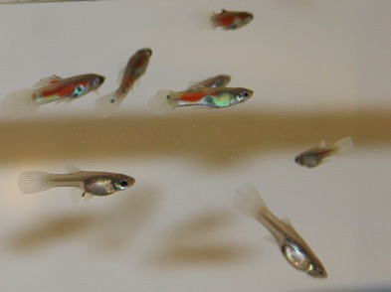
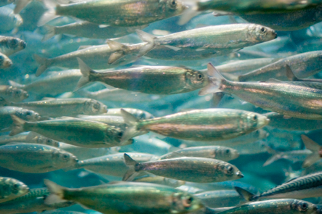
An example of a complex system
Grouping behaviour in fish
Shoaling: (seemingly) disorganised, non-aligned grouping
Schooling: (seemingly) organised grouping, with consistent movement and directionality
But - simple rules obeyed by every individual give rise to emergent complexity in group behaviour

Slide 8
A Netlogo model of simple rules that govern shoaling & schooling
Model the properties of each individual that produce group organisation
Vision
Separation
Alignment
Coherence

Slide 9
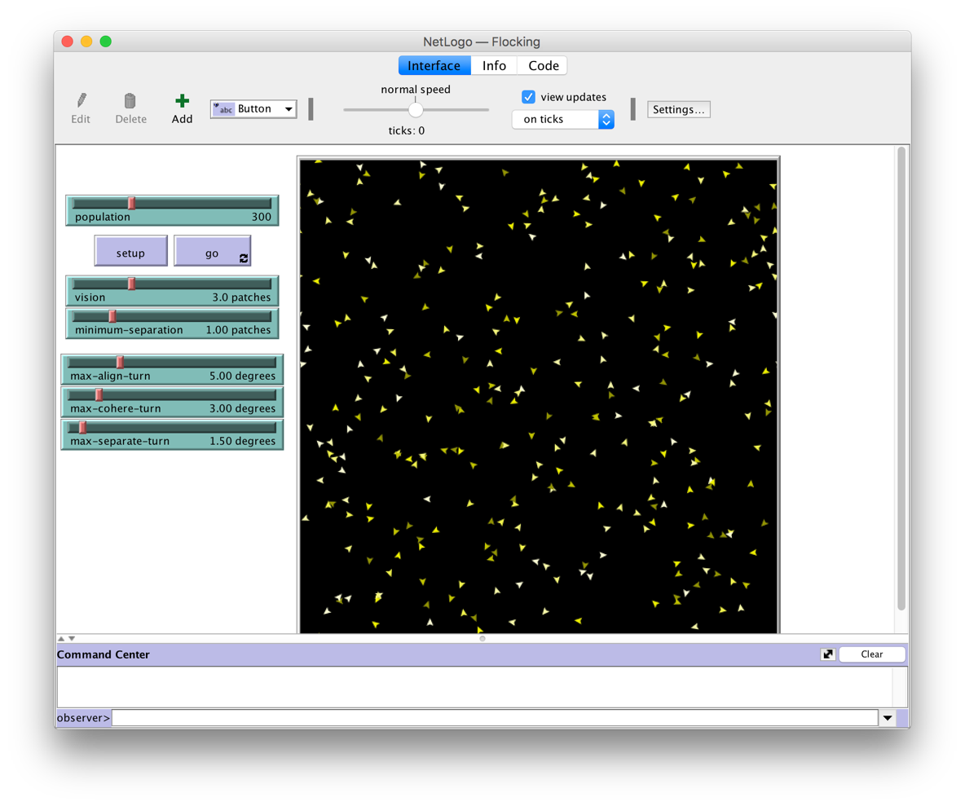
The NetLogo ‘flocking’ model

Slide 10
How to model grouping - parameters
Pop’n = 300; vision = 8, minimum-separation = 1, max-align-turn = 0, max-cohere-turn = 4, max-separate-turn – 1.5. > NO GROUPING
max-cohere-turn = 15 > SHOALING
Change minimum-separation to 0.5 to see density effects
max-align-turn = 1 max-cohere-turn = 1 > SCHOOLING
Change minimum-separation to 0.5 to see density effects

Slide 11
I didn’t write this model…
‘Flocking’ model is included in the NetLogo models library (File > Models library > Biology > Flocking)
Library includes over 200 models, each with comprehensive instructions, and annotated code
Excellent starting point for exploring NetLogo and how you might be able to use it
Models in subjects including: biology, chemistry, physics, psychology, earth science, geography, social science etc.
Well written instructions, targeted at student users
All library models have been checked for reliability etc. by the NetLogo staff
Notes:
Highly coordinated, schooling

Slide 12
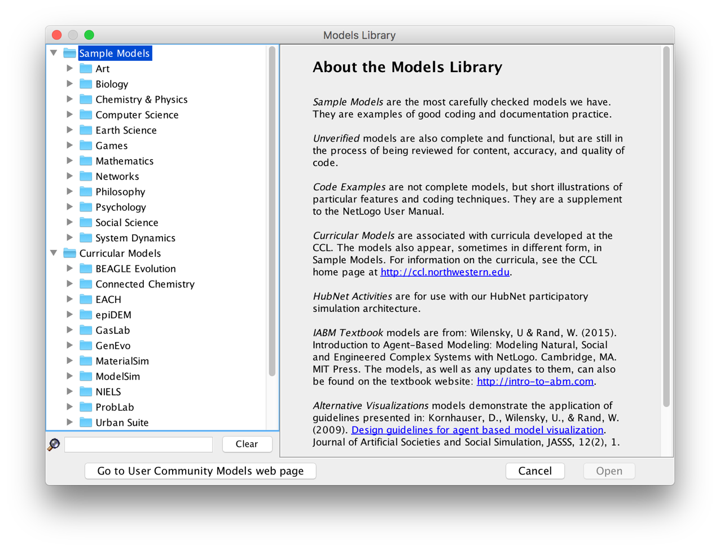
NetLogo models library

Slide 13
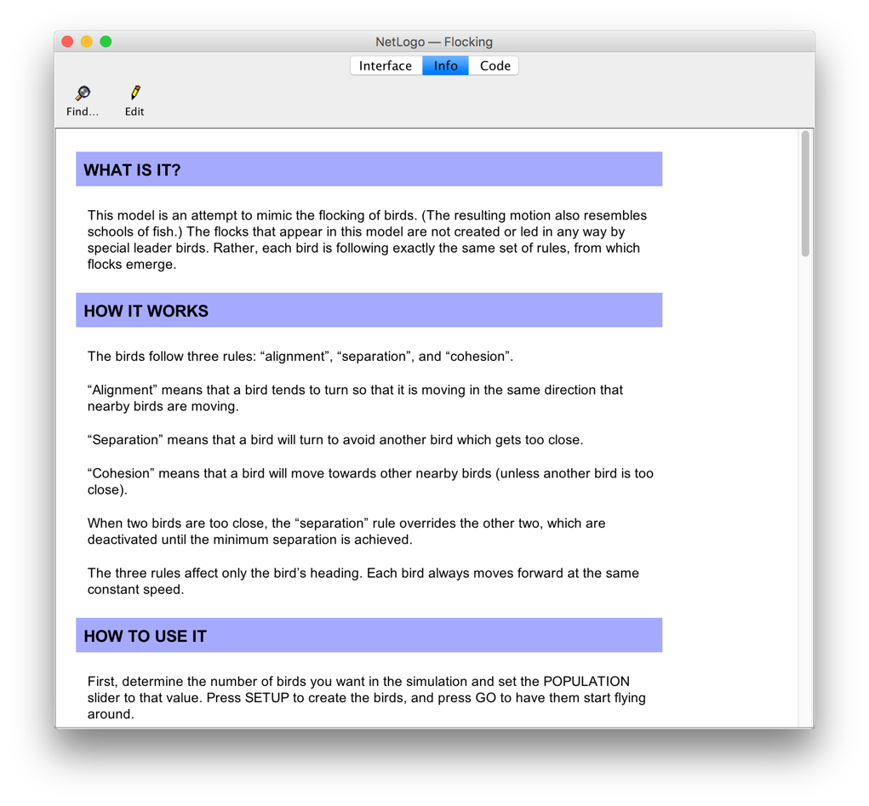
NetLogo model instructions

Slide 14
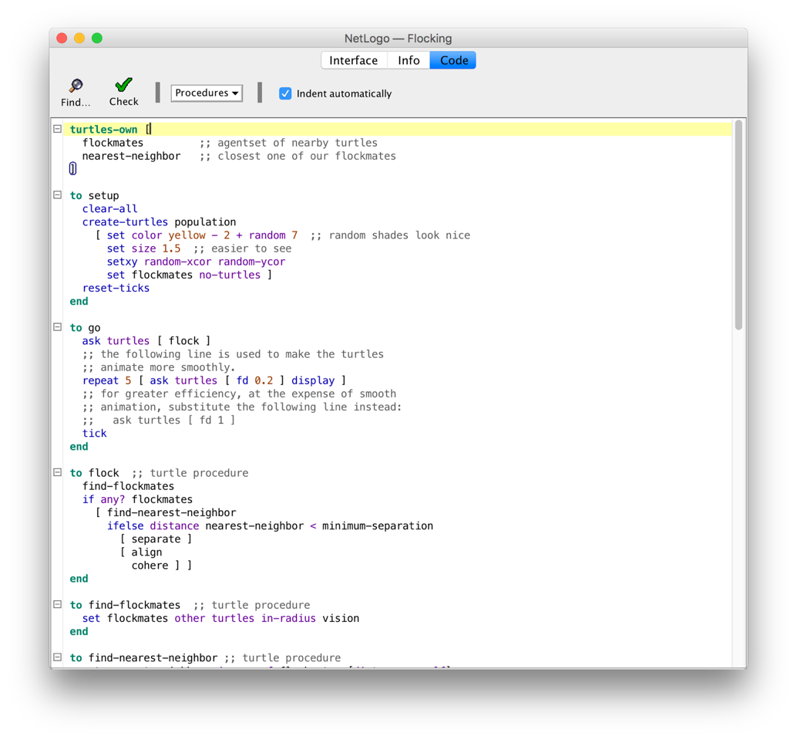
NetLogo model code

Slide 15
How I use NetLogo
In lectures: wakes students up, demonstrates how abstract concepts can actually function
In workshops: helps students how different influences affect a particular system we are studying
In workshops: can gather large amounts of data quickly by getting students to run (e.g.) 10 successive simulations each, then pooling results for large dataset
Across both: helps different learning styles

Slide 16
Other aspects worth mentioning
There is a (relatively) large community of academic NetLogo modellers out there
Models are uploaded by users to the NetLogo community: http://ccl.northwestern.edu/netlogo/models/community/index.cgi and to the NetLogo modelling commons: http://modelingcommons.org/
Over 1000 models – often more complex – can be easily searched and downloaded

Slide 17
Other aspects worth mentioning
Models can also be written so that they are multi-user: this is ideal for student groups
Multiple students can interact in the same model, and see the effect of the actions of different users on a simulated system
Can be run within a single IT classroom (not across multiple rooms)
This is ‘NetLogo hubnet’ – you must set this up for the class, but relatively simple to do

Slide 18
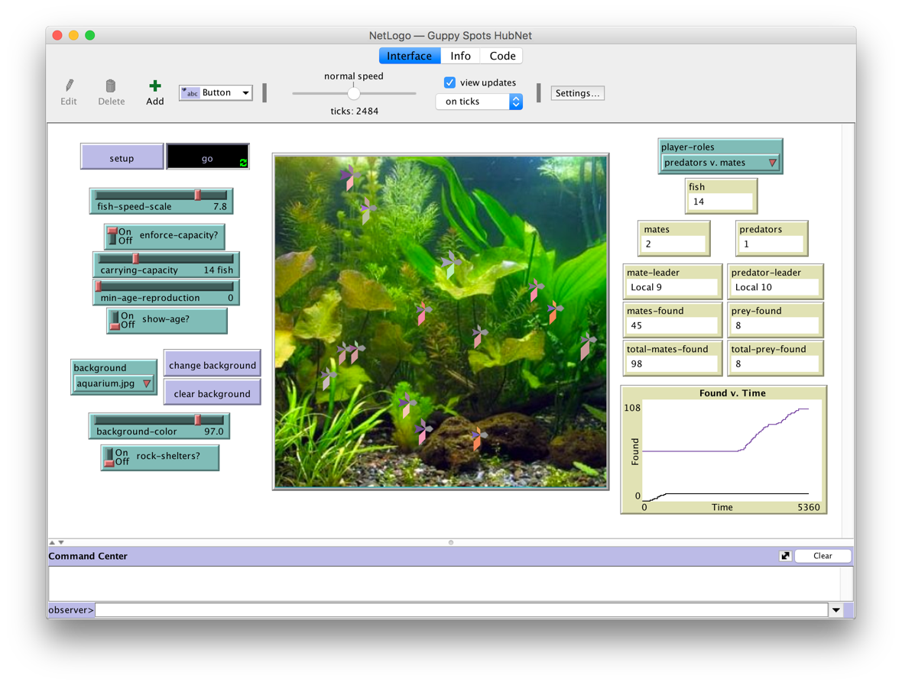
Hubnet example: guppy spots library model

Slide 19
Other aspects worth mentioning
NetLogo is of course an excellent way to teach students to code their own simulations
However it’s beyond my (current) level of expertise
There is a comprehensive 434 page manual for NetLogo included in the download
There is also an MIT Press book about using NetLogo for modelling complex systems

Slide 20
Good models to start with
Open Netlogo, go to file > models library
Biology:
Flocking
Fireflies
Termites
Biology > Evolution:
Bug hunt speeds
Curricular models > BEAGLE Evolution:
DNA replication fork
Gendrift T interact

