Slide 1
Changing VLE

Slide 2
Reasons for change
Staff and student frustrations with Blackboard
Blackboard is focusing on a new tool – few upgrades over the past 4 years
Increasing complexity of running the Blackboard system
System looks its age (15 years) and no recent upgrade
Down time (upgrade)
Bugs fixes on a 3 month cycle

Slide 3
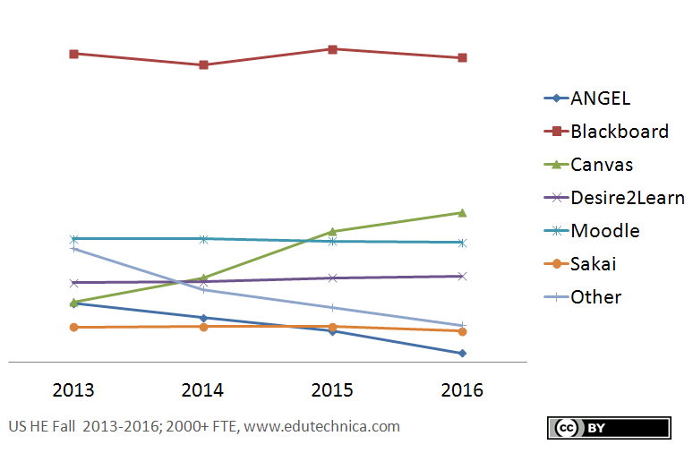
Canvas as a company
2008 – US
2013 – UK Office
18 million users
2,000 institutions
800 employees
Cloud-based (Dublin)

Slide 4
Implementation plan
Started in April
Gathered programme leaders requirements + technical requirements
Procurement
Signed contract
2016
2017
2018

Slide 5
Implementation plan
Started in April
Gathered programme leaders requirements + technical requirements
Procurement
Signed contract
Change freeze in Bb
Migrate content
Non standard modules continue on Bb
All other courses start in Canvas Sept 2017
Blackboard
2016
2017
2018
Canvas
Blackboard closes August 2018

Slide 6
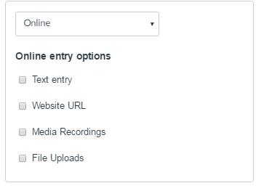
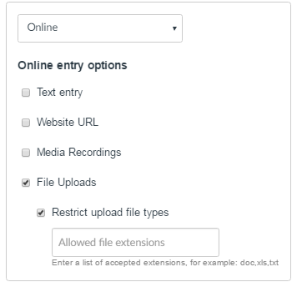
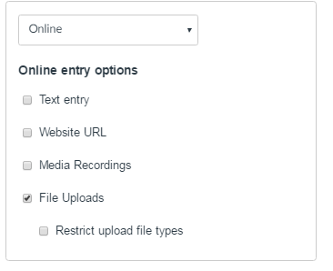
Design and ease of use
1
Designed to enable the majority of staff – not just for the expert
Aim to minimise frustration and making it easier
Fewer bugs – bug fix on a few week cycle
Attempts to minimise repetitive tasks

Slide 7
The core functionality remains the same
2
Core functionality – same as most VLE
Design is concentrated on making the basics as easy as possible
But the edge can connect with new tools as they appear
Design connects with external tools and services e.g. Office 365
Maximises the potential of other tools, rather than attempting to copy them

Slide 8
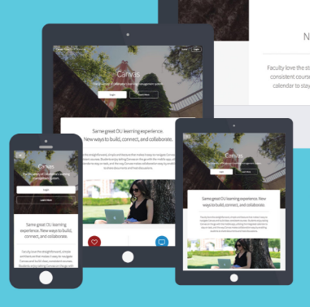
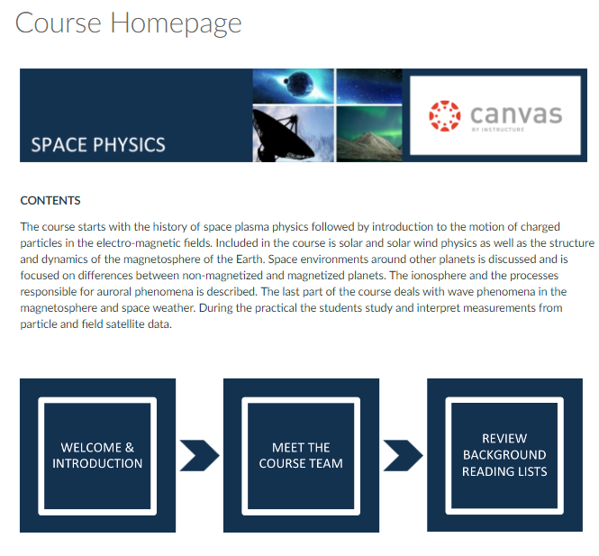
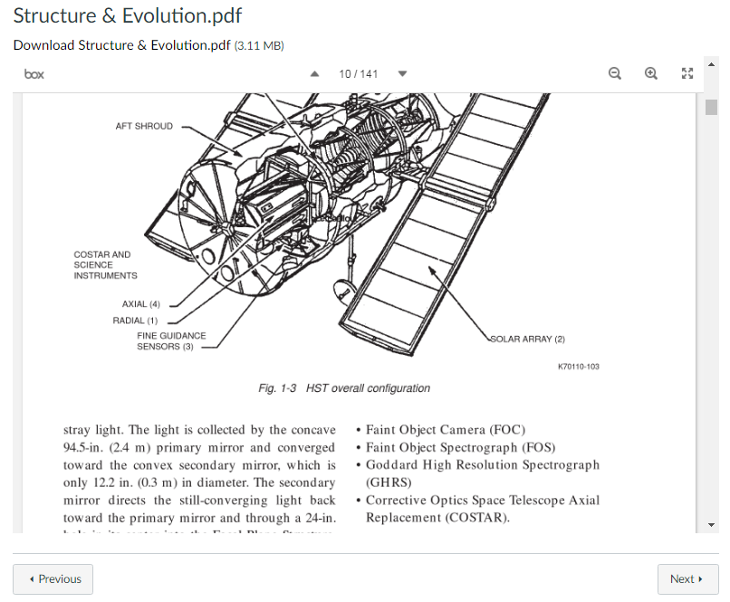
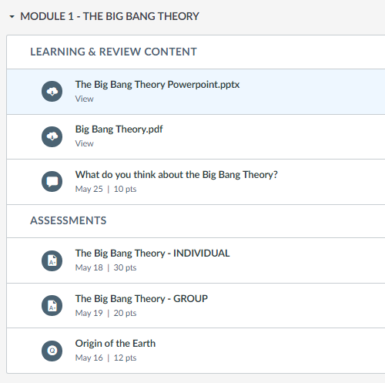
Flexibility in content creation and display
3
‘List of Content’ area
HTML page creation – so it looks like a web site
In page file display
Easy integration of video, images etc
Mobile optimisation

Slide 9
Communication
4
Students can choose to get SMS text messages, alerts directed to twitter + more
Range of notification types e.g. weekly updates
Easy to use discussion board
Media integration – Video + Audio
Enhanced mobile integration
Groups can share office 365 documents
Reply to announcements

Slide 10
Flexible approach to assessment
5
Possibility of an ‘up link’ to SIS
All assessment automatically added to ‘assignment’ and ‘syllabus’ areas
Wider range of assessment types/options e.g. office 365 + OneNote
Better clearer rubric design
Anonymous marking – flexibility, SIS ID
Better display of marking statistics and analytics
Assignment extensions to single/groups
Mastery process to allow branching after tests

Slide 11
24/7 support – You’ll never ‘work’ alone
6
All staff and students will have access to a phone line
And a ‘in canvas’ chat facility
For the next 3 years

