Slide 1
Educational Video and Audio
Powered by Panopto

Slide 2
Introduction to eva
Make recording, storage and delivery of educational video + audio
Easier
More secure
Controlled academic staff
Remove barriers to allow more staff to use media
Investigate the impact on students
educational video + audio service

Slide 3
powered by
Panopto
Existing videos
Desktop and offsite
Live Broadcast
ev
a
Staff recorded presentation
Blackboard
Experiments
YouTube and ITunesU
Guest speakers
Editable
educational video + audio service

Slide 4
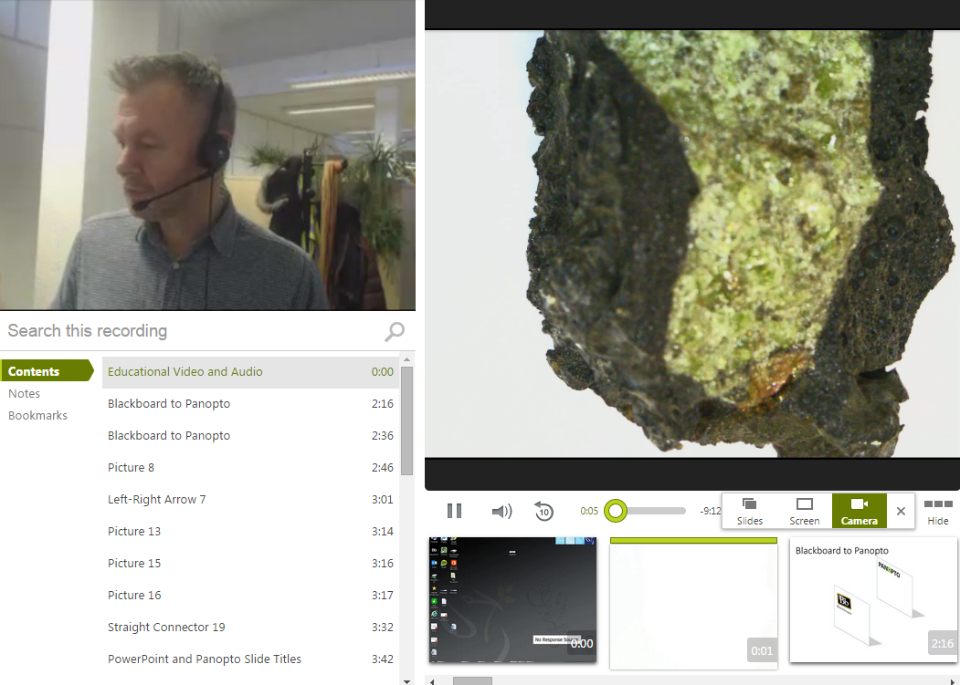

Slide 5
Blackboard to Panopto

Slide 6
PowerPoint and Panopto Slide Titles
Example PowerPoint

Slide 7
PowerPoint and Panopto Searchable Text
The PowerPoint Text
Example PowerPoint
Aims of Session
Beginning
Middle
End
Summary
Next session

Slide 8
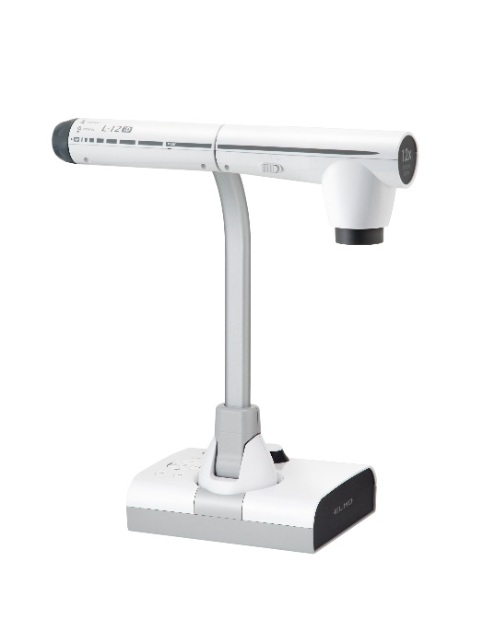
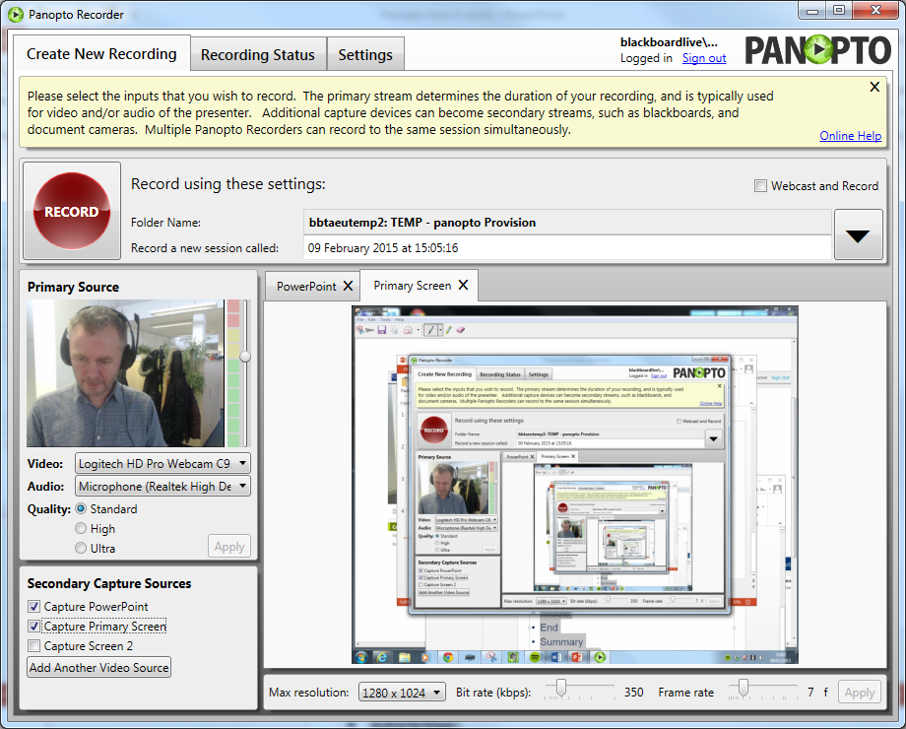
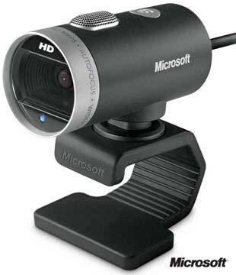
Other Camera Feeds

Slide 9
Screen Capture

Slide 10
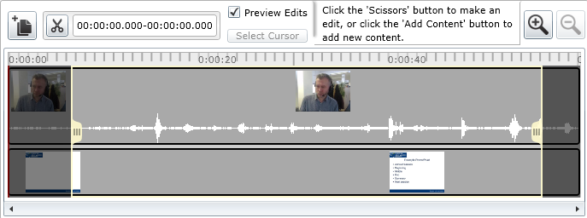
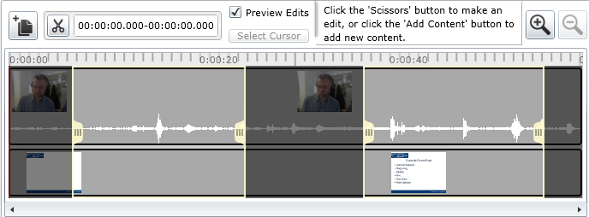
Editing

Slide 11
Live Editing

Slide 12
Altogether

Slide 13
Mobile create and watch

Slide 14
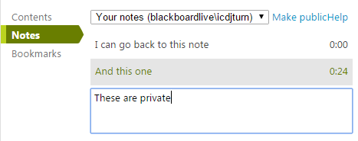
Students can keep notes

