Slide 1
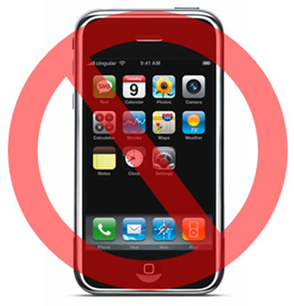
Student Consultation and Textwall Liz Whitfield Geography Programme Leader

Slide 2
Why Textwall?
Textwall and other interactive technology in Geography
Teaching and Learning
Student Consultation
Combination of Textwall and Turning Point
Advantages
Disadvantages….?

Slide 3
Previous exposure
Three L4 and L5 modules utilise Textwall
Simple Q and A sessions within lectures
Discussion driver
Turning point
Several L4 and L5 modules as Q & A revision/learning development

Slide 4
Why Textwall????

Slide 5
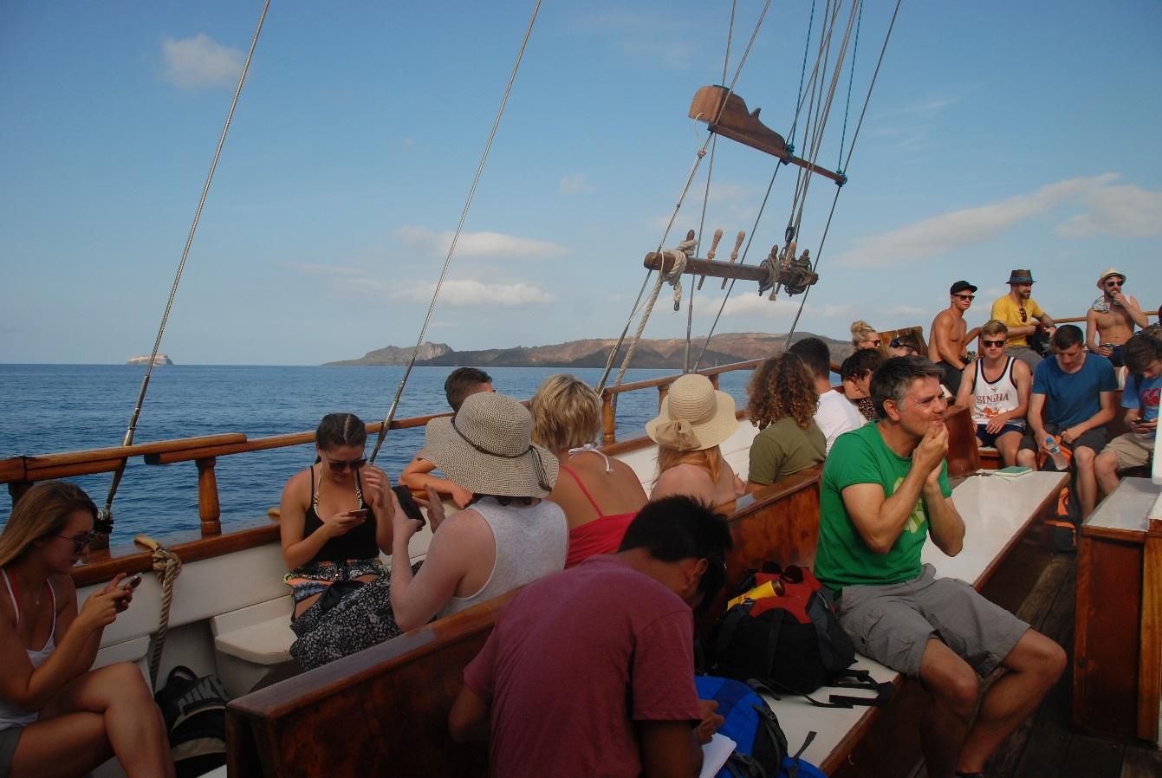
Crete & Santorini Field Class…How many mobile phones can you see???

Slide 7
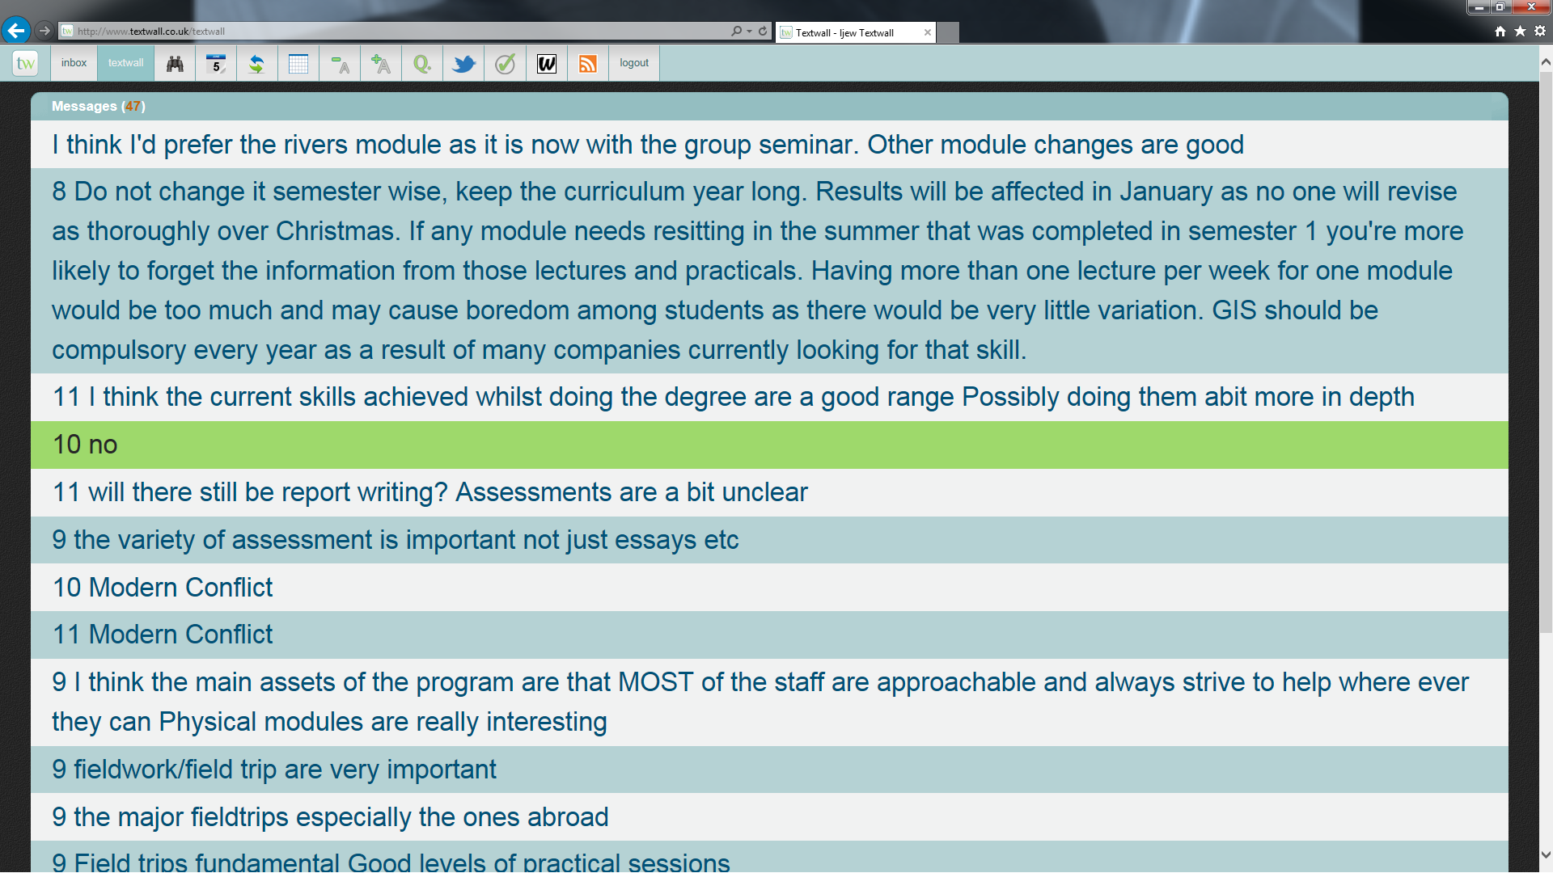

Slide 8
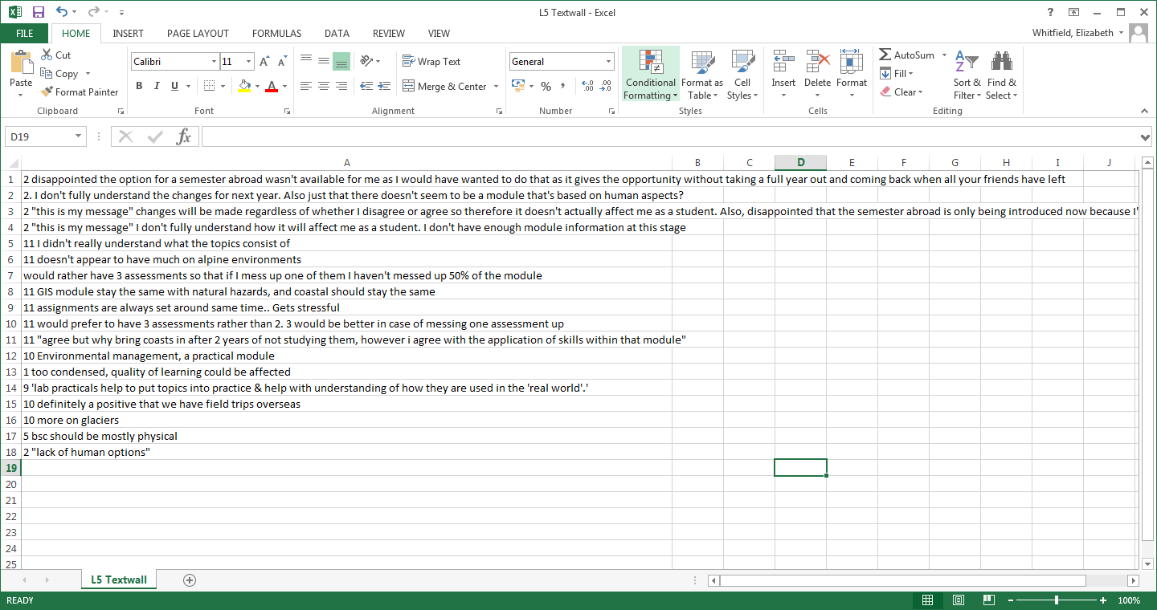
Output into Excel

Slide 9
Advantages
Real time reaction and interaction
Develop on emerging themes
Generate further questions/stimuli for discussion
Hard data to analyse, develop & communicate
Detailed feedback led to further analysis and continued dialogue with student body
(FQAEC/Validation and ReviewTextwall enabled detailed understanding of student opinion
Students like their phones!!!!
TLA audit- NSP biggest users of mobile technology for Bb

Slide 10
Disadvantages
Impromptu/irrelevant feedback
Irrelevant +/or inappropriate messages
Potential for non-related topic discussion?
Exclusive
Prohibits those without mobile technology
Cost?
Level variation potential…..not in this exercise
No disadvantage….???
So why use Textwall….?

Slide 11
How many mobile phones do you see….?

