Slide 1
Faculty of Science 2nd Annual Learning, Teaching and Assessment (LTA) Development Event Wednesday 6th January 2016 Learning technologies within the classroom
Phil Denton
Associate Dean (Education)

Slide 2
Feedback from the last event
Shorter event preferred.
More practitioner–focus welcomed.
More opportunities for discussion.
Timing not ideal, but OK for 14 out of 19 respondents.
Adopt a theme for the day.
Suggested themes: Interactivity in lectures, learning technologies.
Employ the same caterer ;-)
A reminder that all slides will be available via the Faculty’s LTA website after the event.

Slide 3
Some context…
Faculty staff and student numbers are at historically high levels.
Of the four Faculties, Science maintained the highest overall satisfaction in NSS 2015 and rose to secure the highest overall satisfaction in PTES 2015.
2015/16 represents the first year in which all UG students within the Faculty entered under the £9K fees regime.
Two recent surveys give some insights into SCS students experiences of their courses…

Slide 4
UK Engagement Survey Dec 2015
Involved 1988 LJMU non-final year UG students (535 SCS).
Covers seven categories: Critical Thinking, Learning with Others, Interacting with Staff, Reflecting and Connecting, Course Challenge, Staff-student Partnership, Time Spent.
Average of the categories is 56% for LJMU, 1% below sector.
LJMU results for four categories are equal to the sector mean, the remaining two categories being 2% below.
In all categories, EHC and APS are at or above LJMU average, TAE and SCS are at the LJMU average or below.

Slide 5
Critical Thinking: Typical divide between SCS/TAE and EHC/APS is evident but is in line with subject trends.
Learning with Others: LJMU students, notably STEM and non-EU, rely on informal peer learning less than other UK students.
Reflecting and Connecting: SCS lowest for “(How often you…) Connected your learning to real-world problems or issues.”
Course Challenge: Only category where SCS matches the LJMU average.
Staff-Student Partnership: SCS scores the same as TAE. EHC, notably Nursing, scores very high.
Interacting with Staff: 17% of SCS students report interacting with staff outside of taught sessions c.f. 27% of non-SCS UGs.

Slide 6
Time spent: Students undertaking more than 6 hrs pw/%
 | Taught sessions | Private study | Extra-curricular | Paid Work | Voluntary work | Care for dependants | Commuting to campus
Sector | 86 | 78 | 59 | 43 | 26 | 18 | 82
Post-92 | 86 | 75 | 48 | 51 | 26 | 23 | 86
LJMU | 90 | 69 | 42 | 46 | 22 | 19 | 85
APS | 89 | 69 | 41 | 49 | 20 | 17 | 83
EHC | 86 | 71 | 43 | 54 | 36 | 30 | 93
SCS | 94 | 65 | 43 | 39 | 21 | 17 | 82
TAE | 92 | 73 | 46 | 41 | 14 | 13 | 83

Slide 7
LJMU Graduation Survey 2015
Around half of all respondents had undertaken full-time work at some point during their studies, although there were some notable variations:

Slide 8
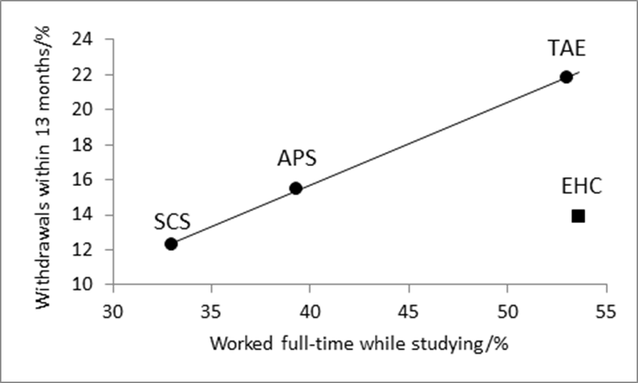
Your views/experiences of influence of students’ other commitments on their academic progress?

Slide 9
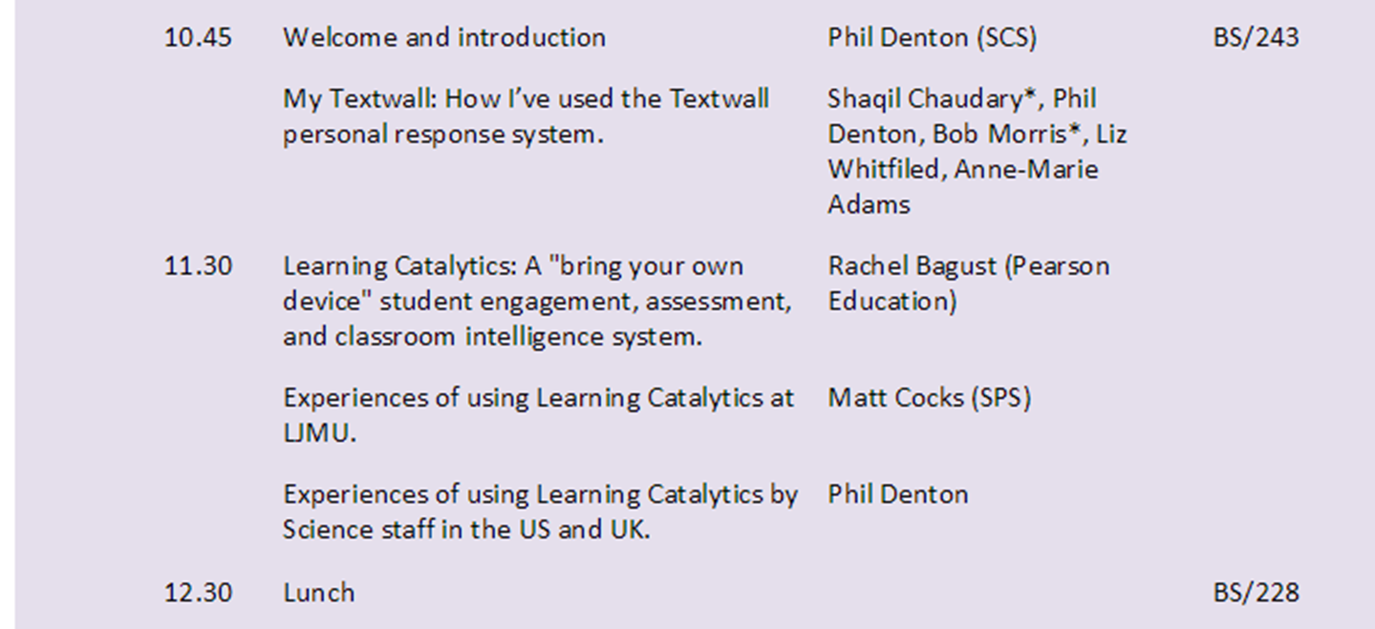
http://wowie.ljmu.ac.uk/FacultyLTA/Home.htm
Home > Good practice Sharing > Staff development events arranged by the Faculty

Slide 10
http://wowie.ljmu.ac.uk/FacultyLTA/Home.htm
Home > Good practice Sharing > Staff development events arranged by the Faculty

